Slide 1
BUILDING BRIDGES TO SUPPORT SCHOOL AND SYSTEM LEADERSHIP
PHILADELPHIA ACADEMY OF SCHOOL LEADERS
DECEMBER 10TH – 8:45 – 10:45 A.M.
Generously Supported by Neubauer Family Foundation
LEARNING FORWARD CONFERENCE | BOSTON, MA DECEMBER 10, 2025

Slide 2

WELCOME & INTRODUCTIONS
DR. AL BERTANI & EDWIN M. QUEZADA, EdD
DECEMBER 10, 2025

Slide 3
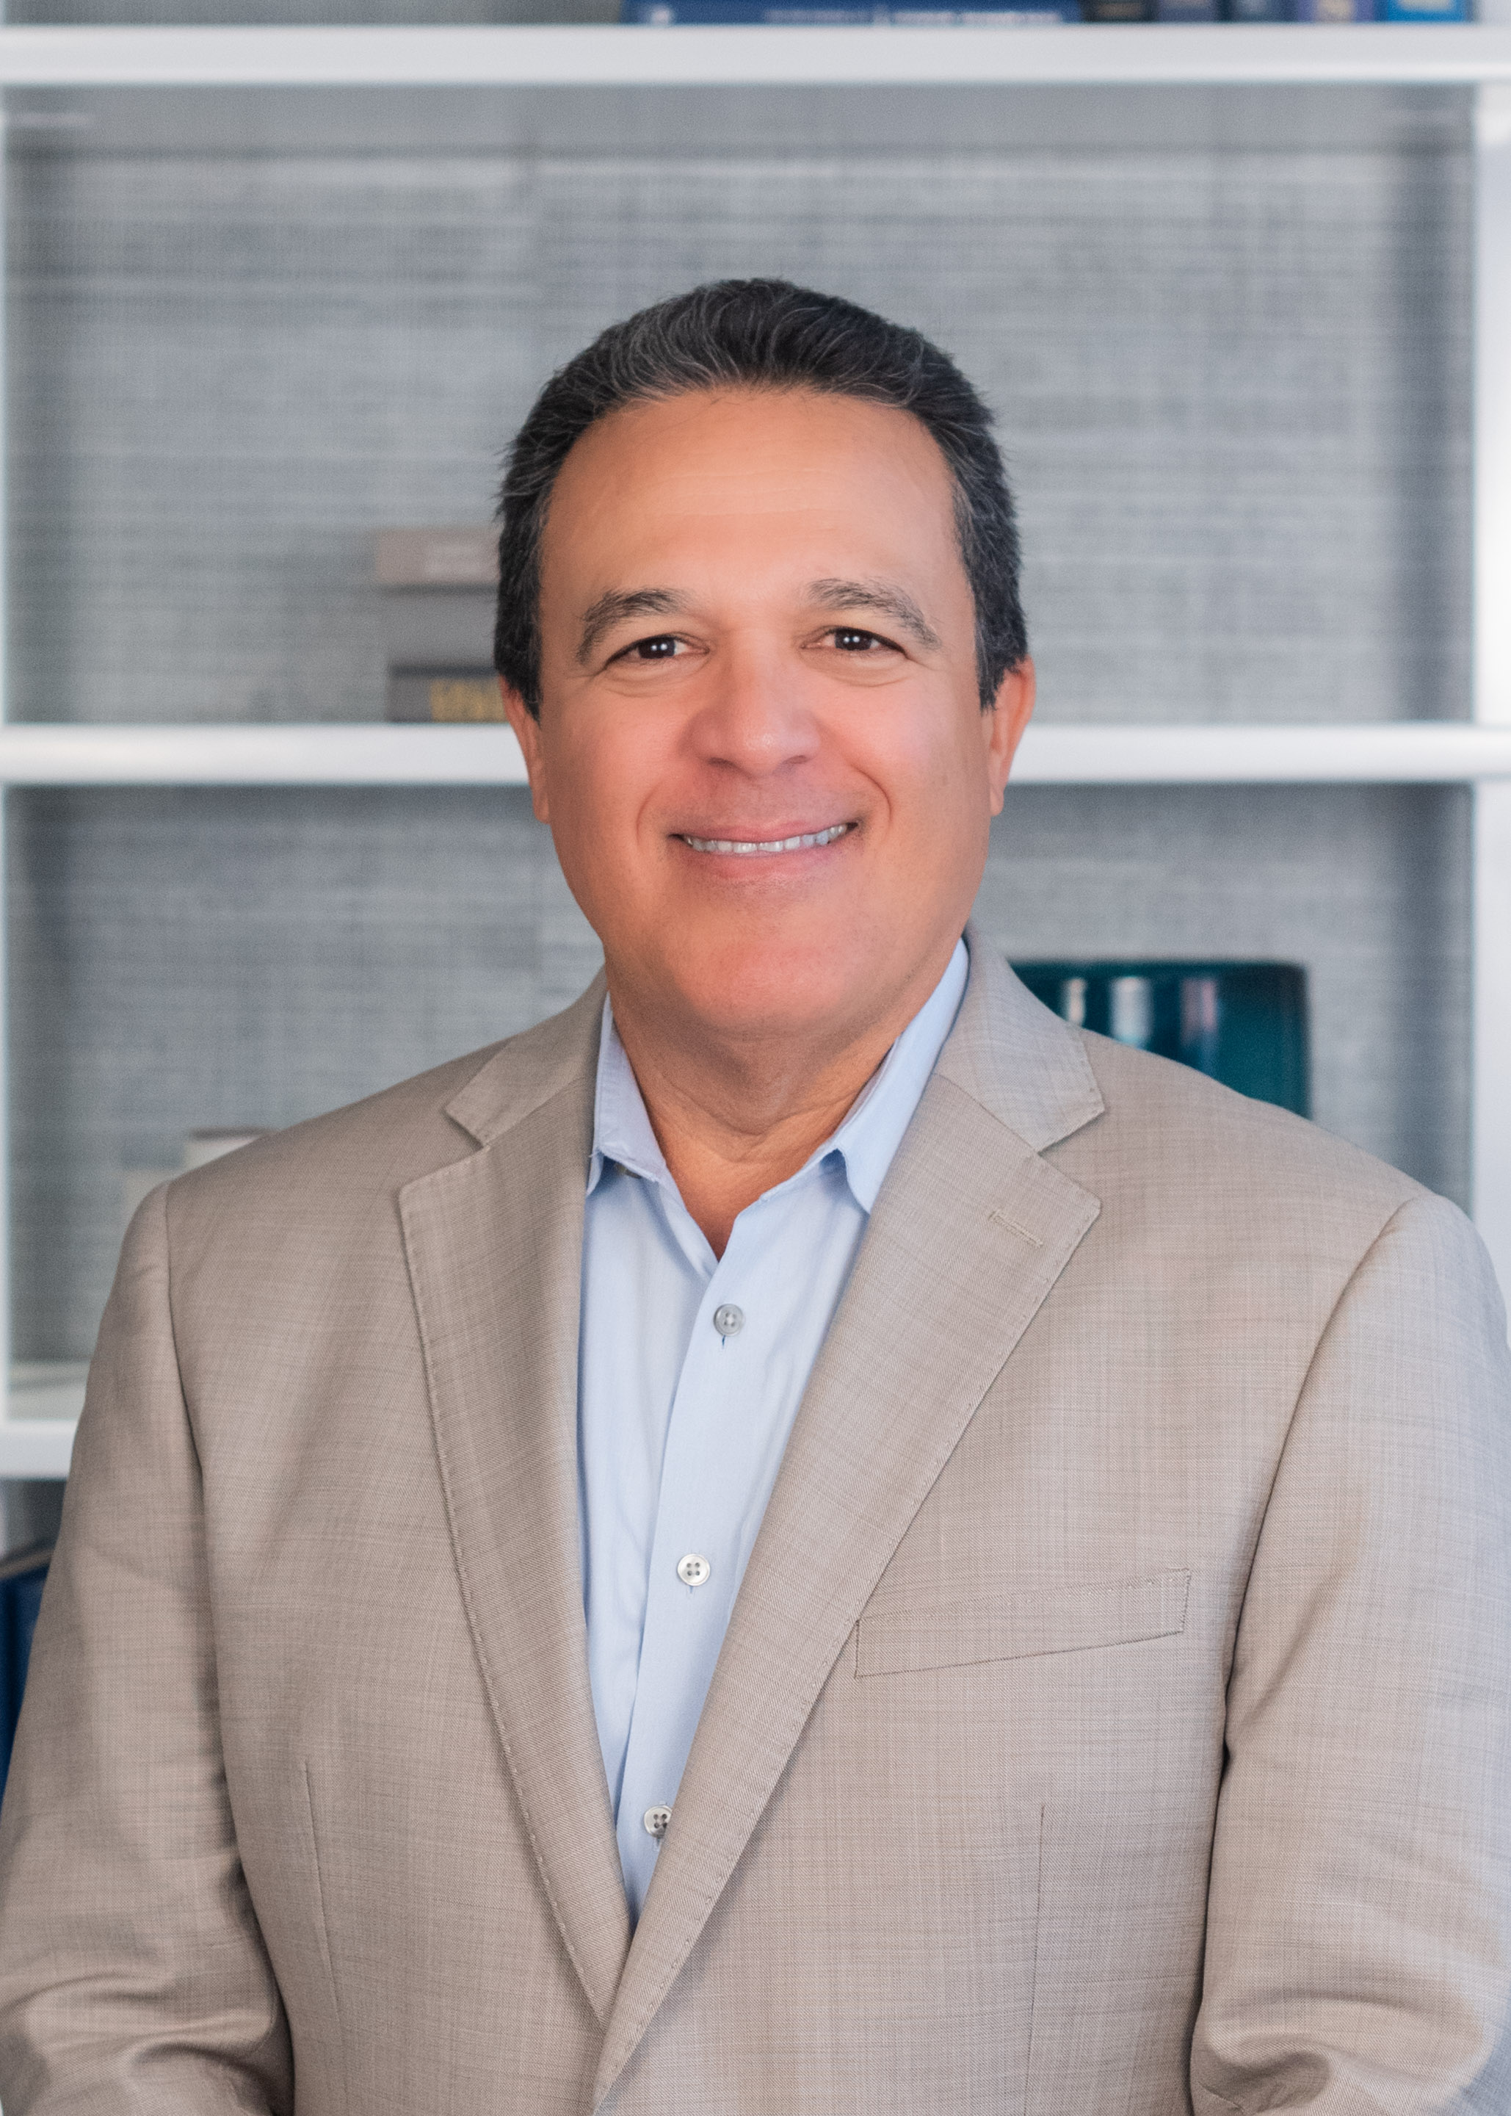
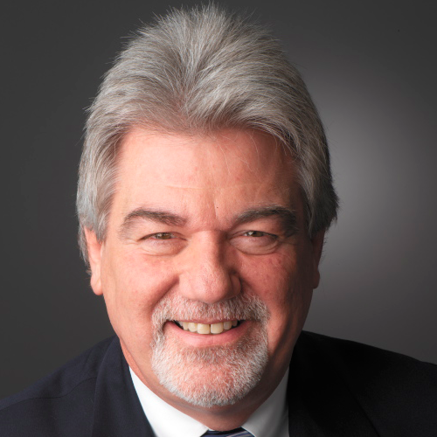
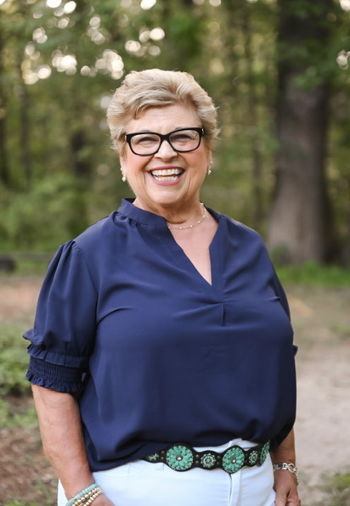
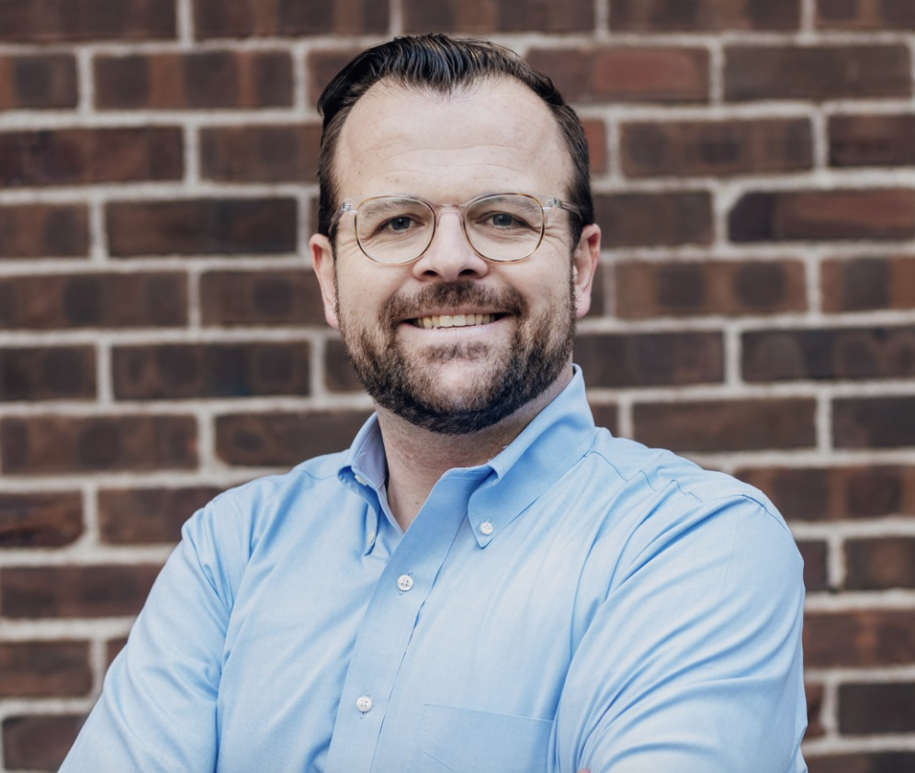
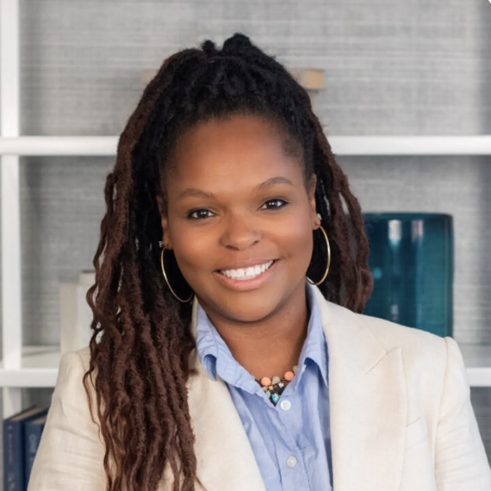
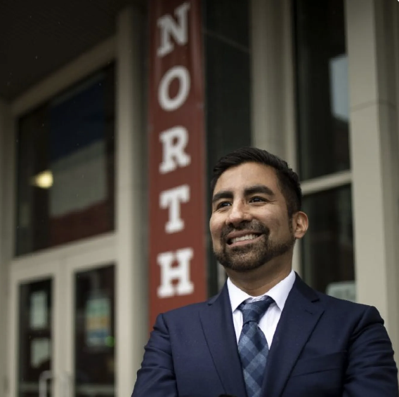

Slide 4
PARTICIPANT OUTCOMES
Learn about the history of the DESIGN, DEVELOPMENT, AND EVOLUTION of PASL’s Programming
Detail the impact of PASL’s programs on STUDENT LEARNING AND LEADERSHIP PIPELINES AND PATHWAYS.
Engage in deep dives about – the NEUBAUER FELLOWSHIP and LEADER OF LEADERS Programs.
Explore the recently REDESIGNED LEADERSHIP COMPETENCIES that undergird PASL’s Programs.
DECEMBER 10, 2025
Notes:
AL Al will let the room know the journey we are about to embark on

Slide 5
MISSION & VISION
Our Mission
To provide quality programming that engages, develops, and supports transformative K–12 educational leaders who authentically embrace equity, inclusion, and educational excellence for every child in Philadelphia.
Our Vision
We work so that all Philadelphia students receive an excellent educational experience, advanced through innovative, effective leadership, that supports their achievement and social-emotional growth to realize success in and beyond the K–12 experience.
DECEMBER 10, 2025
Notes:
Edwin

Slide 6
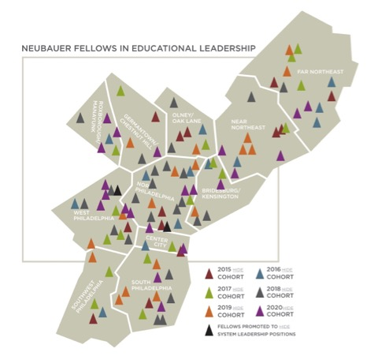
WHERE WE WORK
Currently lead:
76 district schools
25 non-SDP schools
36
50%
66%
34%
people of color
promoted to system- level leadership roles*
* 18 are SDP leaders
DECEMBER 10, 2025
Notes:
edwin

Slide 7
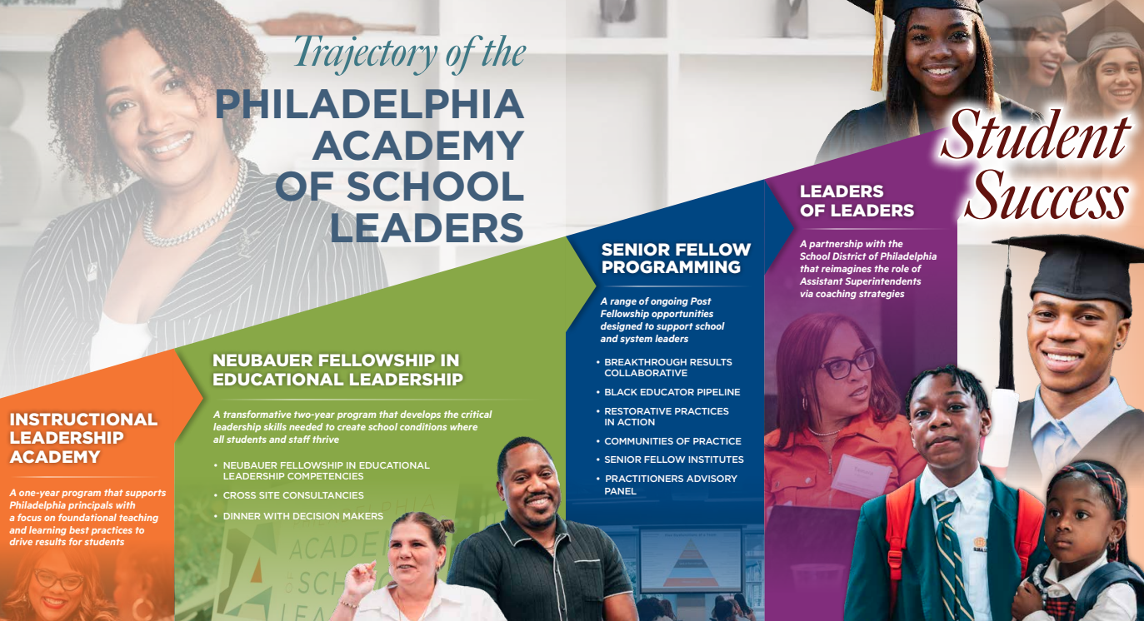
Notes:
EDWIN

Slide 8
PASL DESIGN ORIGIN STORY
AL BERTANI
DECEMBER 10, 2025
Notes:
Al

Slide 9
THE DESIGN CHALLENGE
How would you organize the design process to create a Leadership Development program to support the on-going learning of school and system leaders across Philadelphia?
POINT AND GO PROCESS
Stand-Up – Catch the eye of a colleague at another table.
Find a space for a 5-minute stand-up conversation.
Identify important considerations for the design challenge.
Be prepared to share your ideas.
Notes:
Al

Slide 10
ORIGIN STORY | PHILADELPHIA ACADEMY OF SCHOOL LEADERS
Researching
Leadership
Development Models
The Ask
and the
Invitation
Building an Infrastructure
Horizon Scan of the Context
Institute Design
Recruitment
And
Selection
Staffing the Institute
Engagement Methods
Notes:
Al

Slide 11
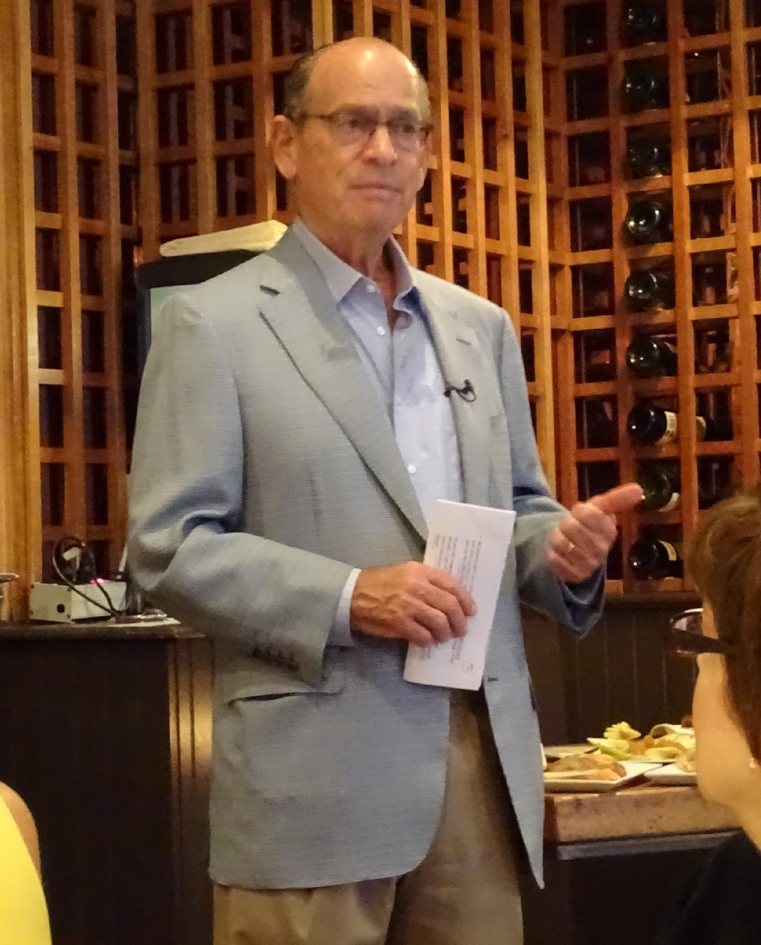
PASL ORIGIN STORY | THE BEGINNING (2014 – 2015)
THE ASK AND THE INVITATION
University of Chicago – Joe Neubauer, Board Chairman
Urban Education Institute – Tim Knowles, Executive Director
UEI Senior Advisor – Al Bertani
Role of the Neubauer Family Foundation
THE ASK & THE INVITATION
HORIZON SCAN OF THE CONTEXT
BUILDING AN INFRASTRUCTURE
RESEARCHING LEADERSHIP DEVELOPMENT MODELS
ENGAGEMENT METHODS
RECRUITMENT & SELECTION
INSTITUTE DESIGN
STAFFING THE INSTITUTE
Notes:
Al

Slide 12
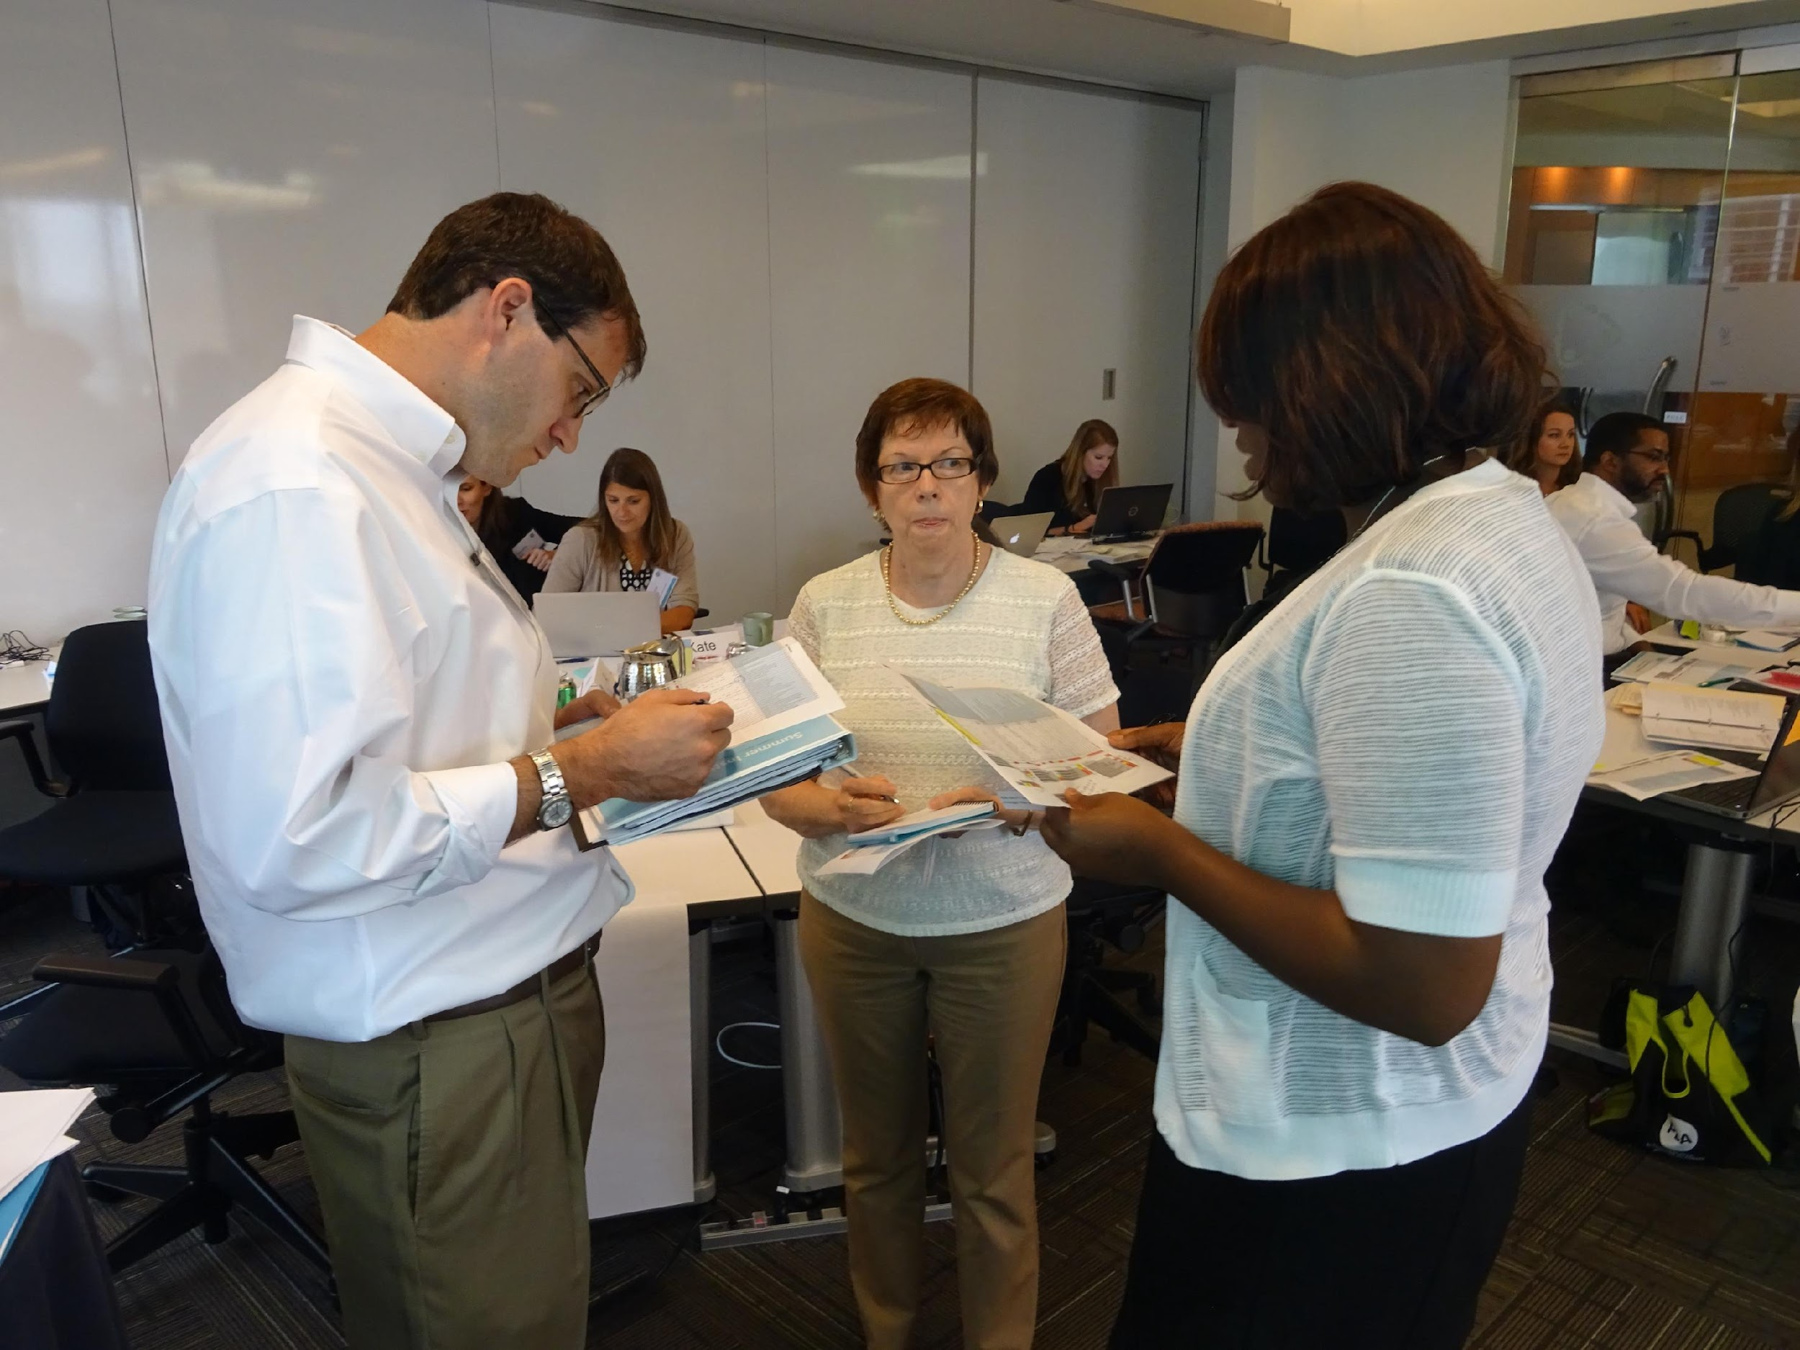
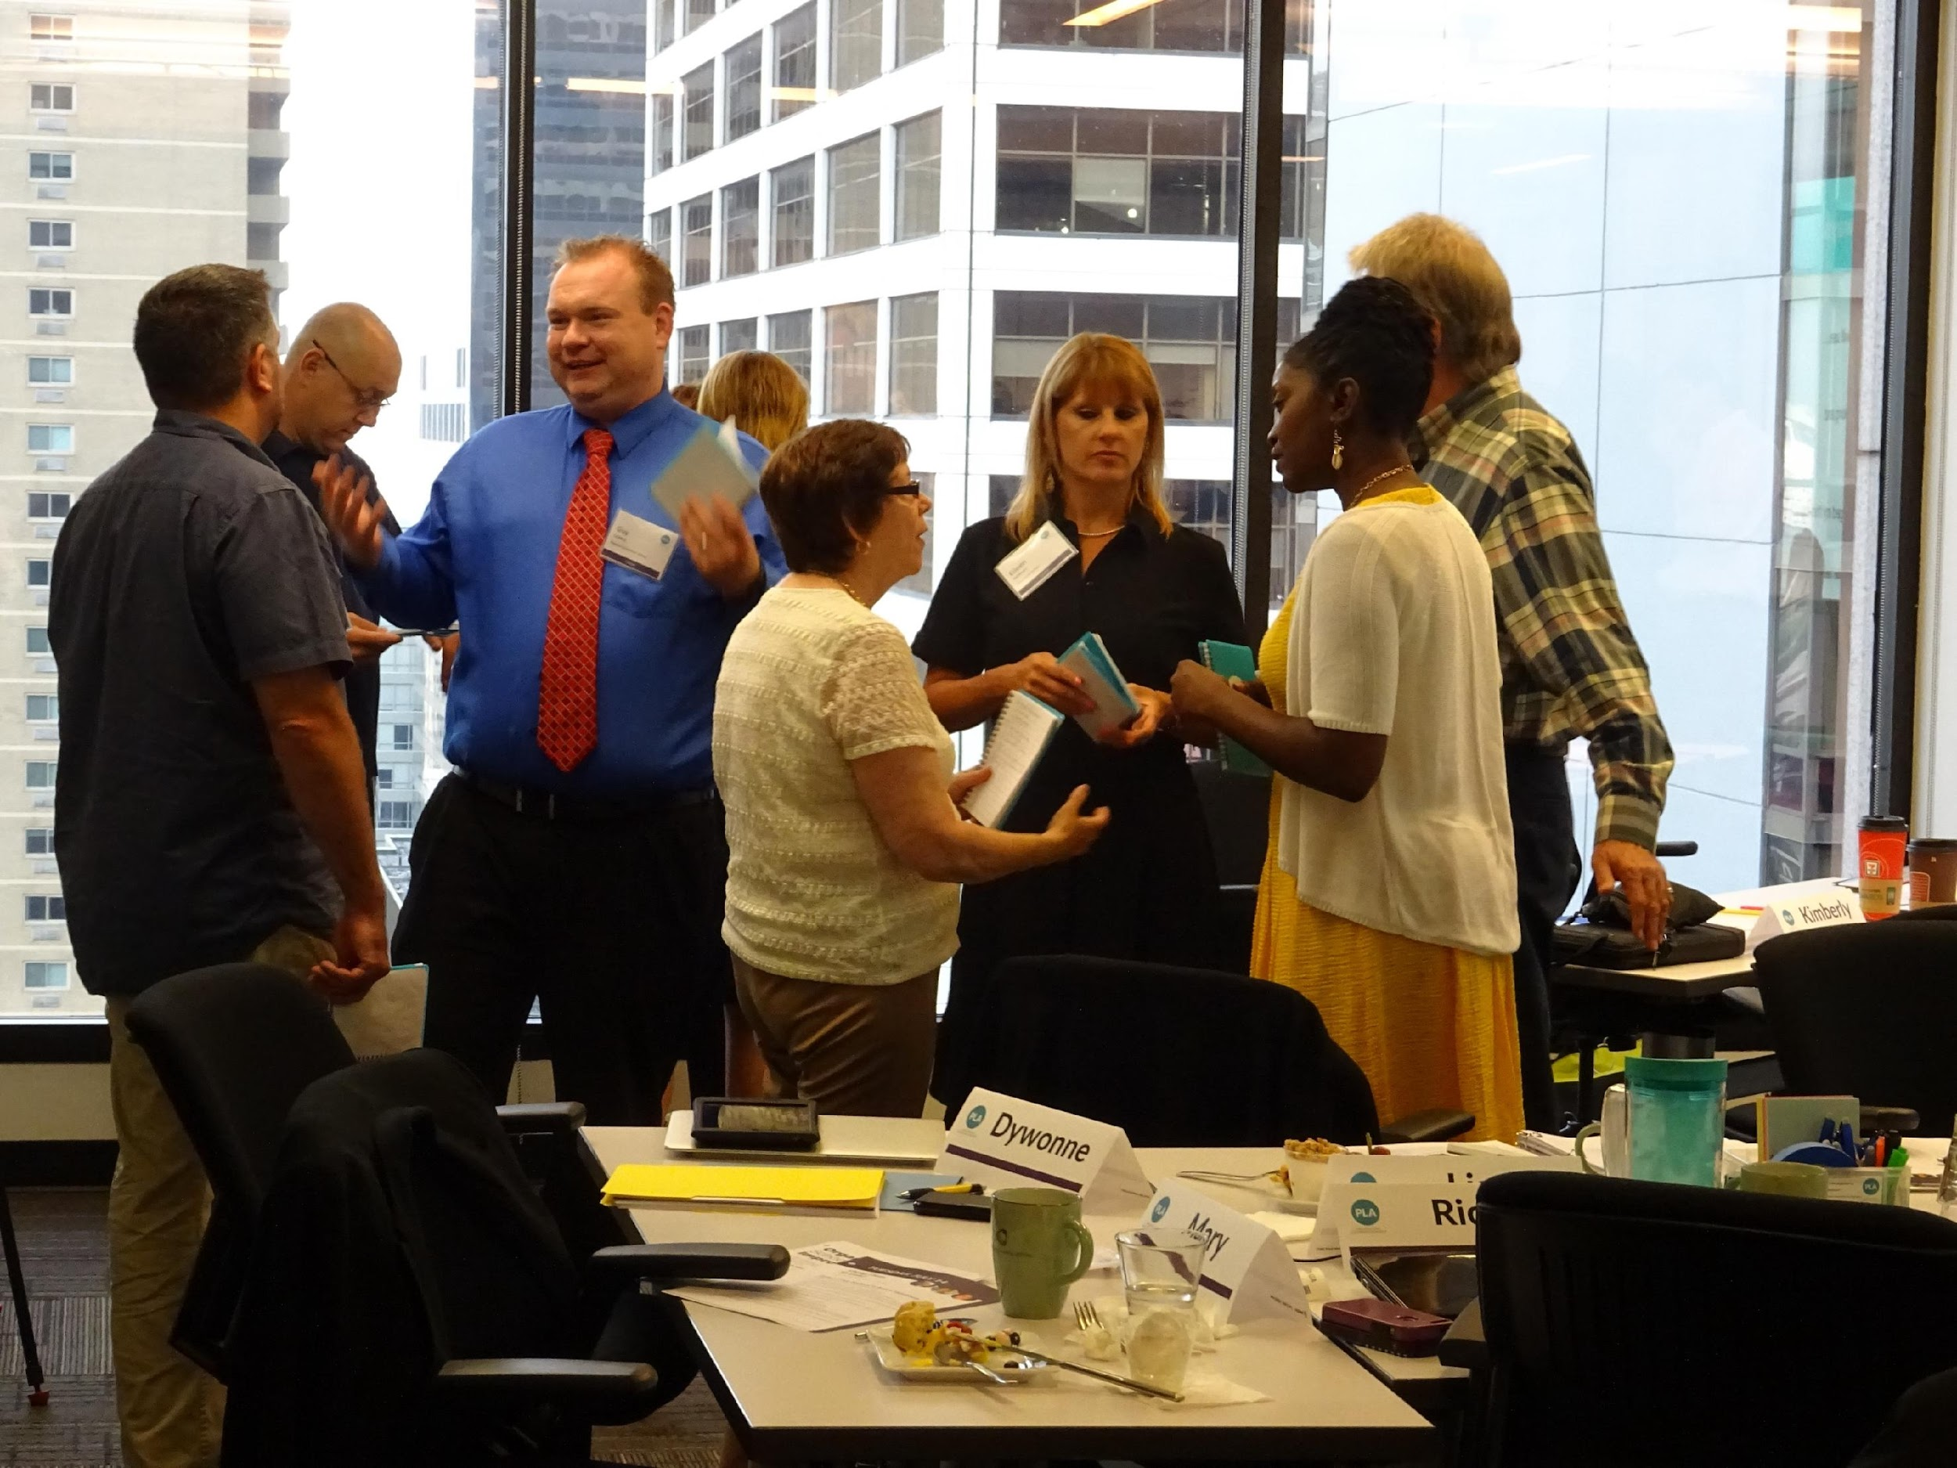
PASL ORIGIN STORY | PHASE II
BUILDING AN INFRASTRUCTURE
Identifying a small cross-sector Steering Team
Nominating individuals to serve on the Design Team
Establishing protocols for communicating progress
Developing a cadence for regular meetings
THE ASK & THE INVITATION
HORIZON SCAN OF THE CONTEXT
BUILDING AN INFRASTRUCTURE
RESEARCHING LEADERSHIP DEVELOPMENT MODELS
ENGAGEMENT METHODS
RECRUITMENT & SELECTION
INSTITUTE DESIGN
STAFFING THE INSTITUTE

Slide 13
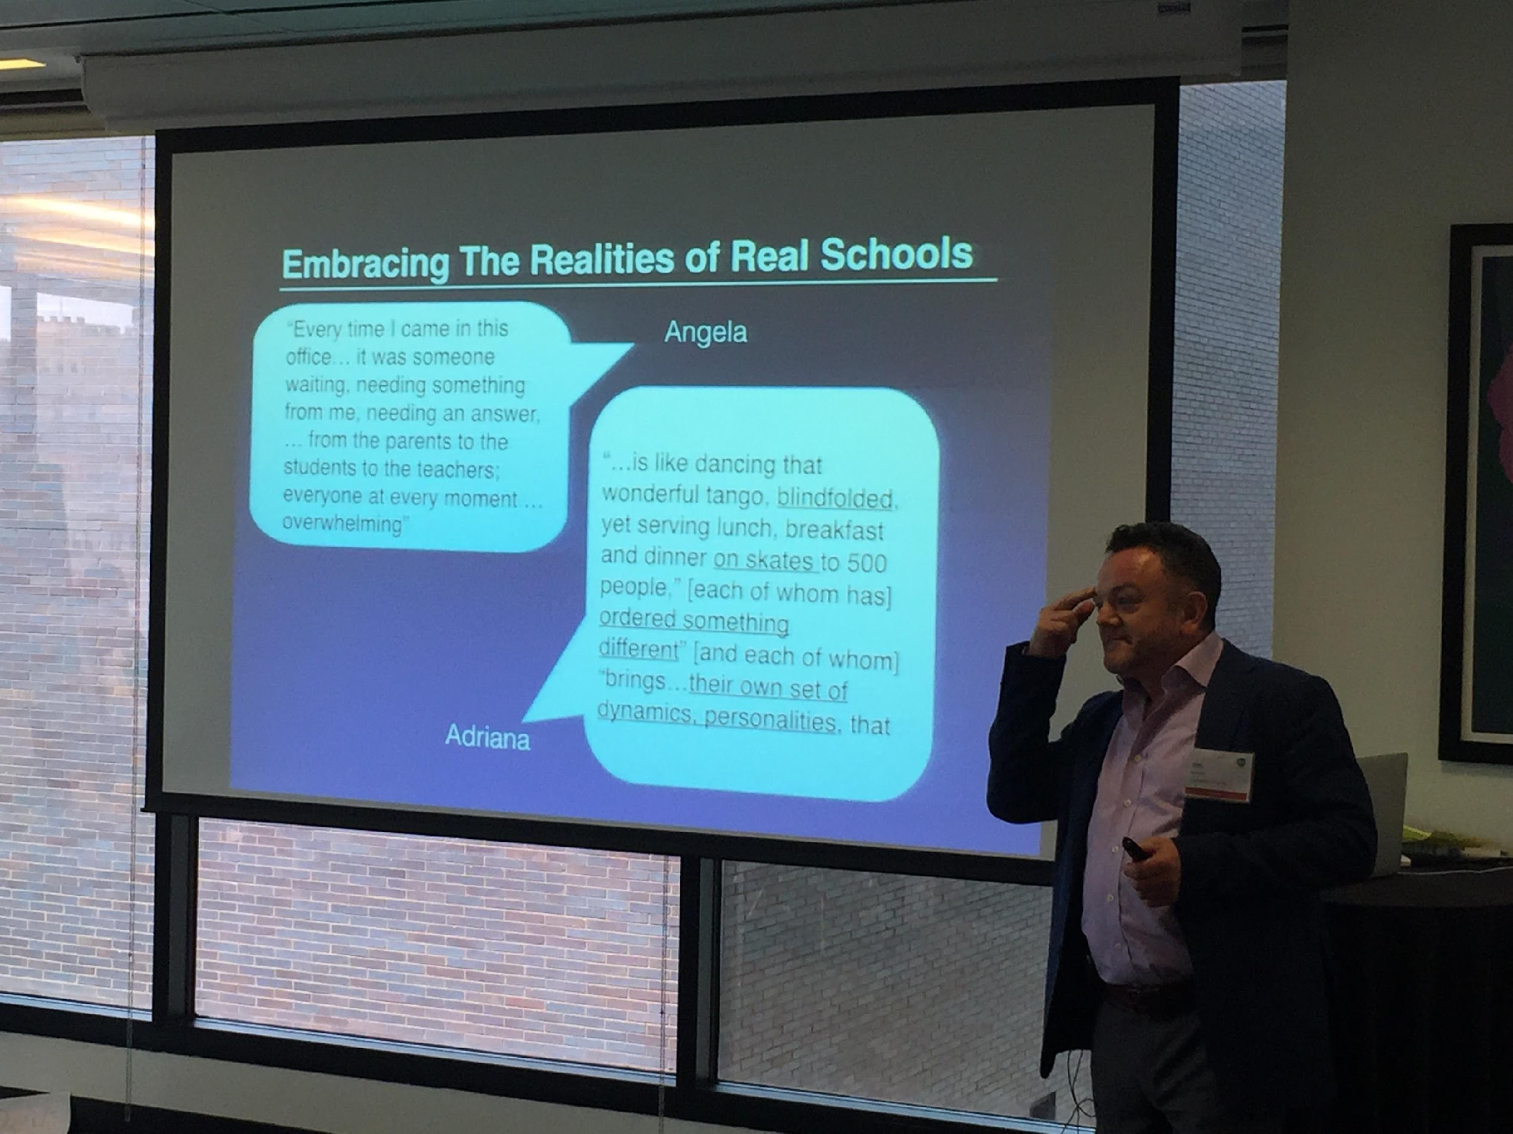
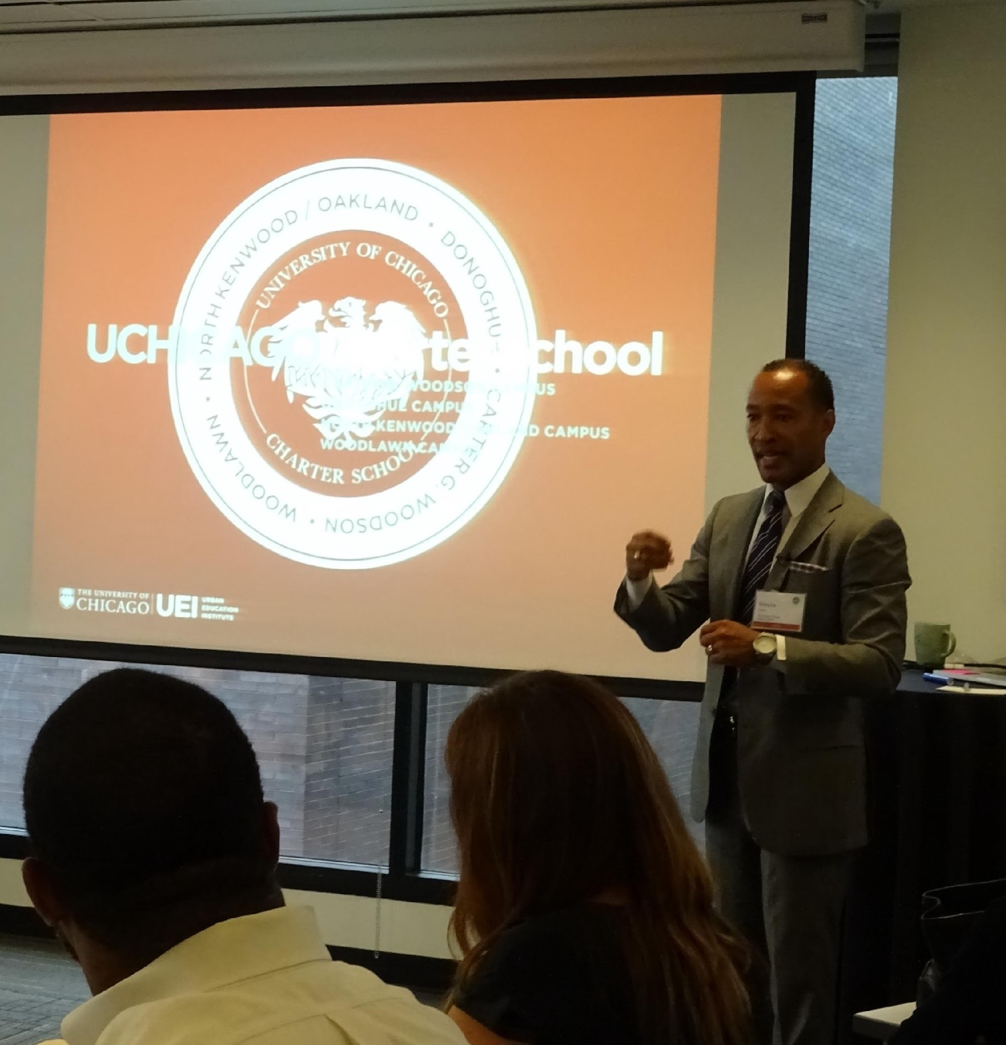
PASL ORIGIN STORY | PHASE III
RESEARCHING LEADERSHIP DEVELOPMENT MODELS
Leading principal development programs from across the U.S.
Leadership programs from across the globe
Executive Leader development models from the business sector
Model components – Program, Cohort, Coaching, Cross-Site
THE ASK & THE INVITATION
HORIZON SCAN OF THE CONTEXT
BUILDING AN INFRASTRUCTURE
RESEARCHING LEADERSHIP DEVELOPMENT MODELS
ENGAGEMENT
METHODS
RECRUITMENT & SELECTION
INSTITUTE DESIGN
STAFFING THE
INSTITUTE
Notes:
Al – why is it important to bring all sectors together with private funding?

Slide 14
PASL ORIGIN STORY | PHASE IV
Engagement Methods
Focus groups to jump-start process and build interest
Identify Design Team Members across sectors (Principals)
Think Tank Design Challenge
Review and Feedback Groups as Design Work progressed
THE ASK & THE INVITATION
HORIZON SCAN OF THE CONTEXT
BUILDING AN INFRASTRUCTURE
RESEARCHING LEADERSHIP DEVELOPMENT MODELS
ENGAGEMENT
METHODS
RECRUITMENT & SELECTION
INSTITUTE DESIGN
STAFFING THE
INSTITUTE
Notes:
Al

Slide 15
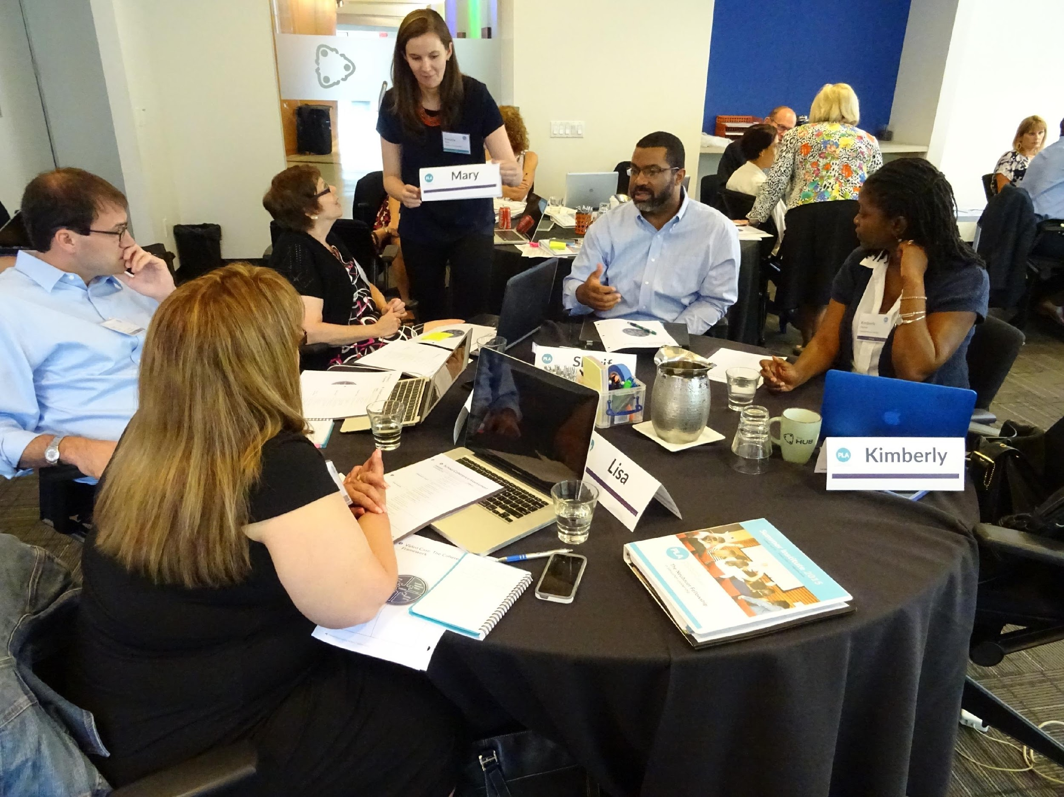
PASL ORIGIN STORY | PHASE V
Recruitment And Selection
Target audience for recruitment across
sectors
Develop a written application requiring school data
Establish selection criteria – Role of Steering Team
Identify and coordinate Interview Committees
THE ASK & THE INVITATION
HORIZON SCAN OF THE CONTEXT
BUILDING AN INFRASTRUCTURE
RESEARCHING LEADERSHIP DEVELOPMENT MODELS
ENGAGEMENT
METHODS
RECRUITMENT & SELECTION
INSTITUTE DESIGN
STAFFING THE
INSTITUTE
Notes:
Al

Slide 16
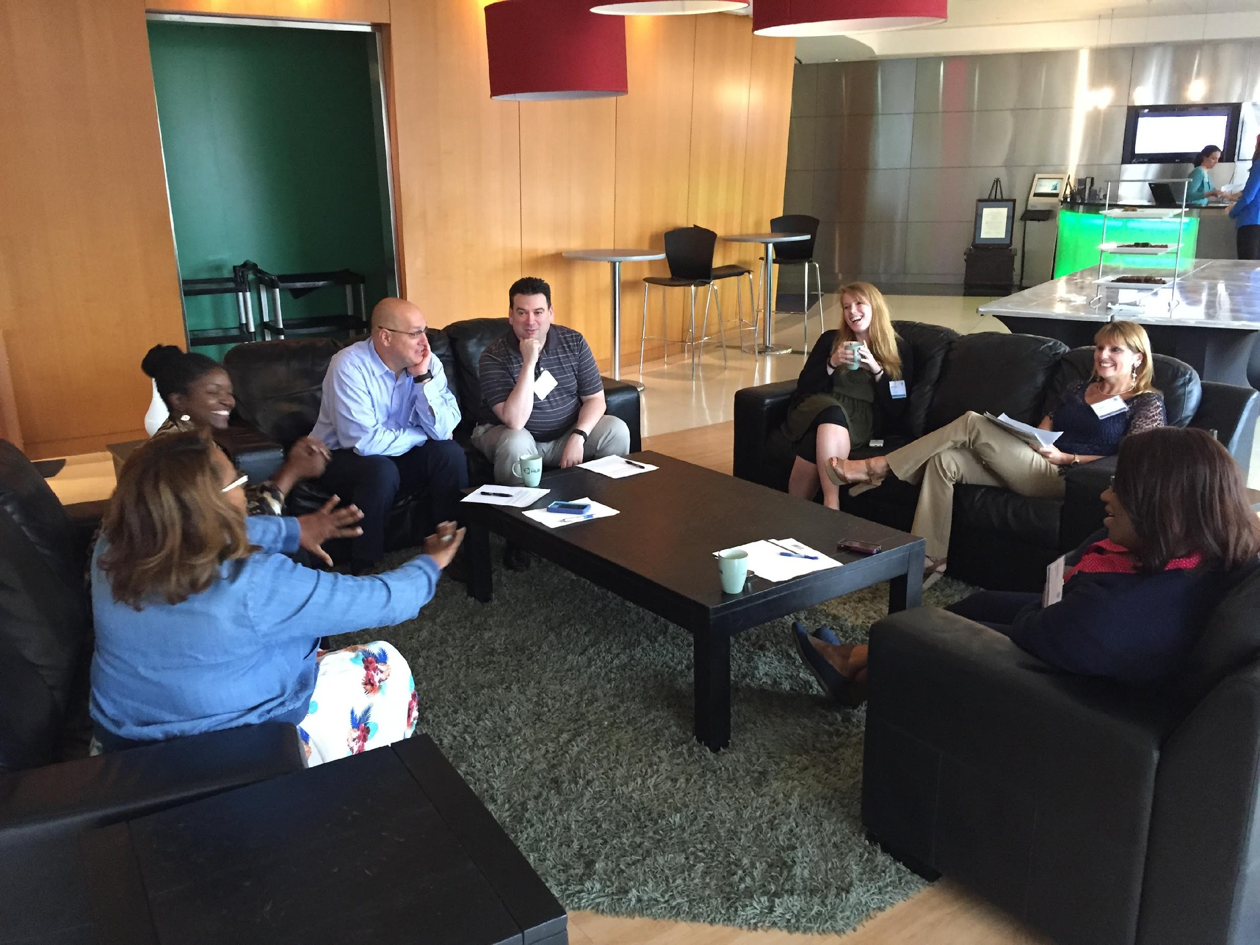
PASL ORIGIN STORY | PHASE VI
Institute Design
Determine content anchors based
on inputs and research
Use Think Tank to outline possible
visions for the Institute
Outline scope and sequence for week-long experience
Stress test the proposed design with Steering and Design Teams
THE ASK & THE INVITATION
HORIZON SCAN OF THE CONTEXT
BUILDING AN INFRASTRUCTURE
RESEARCHING LEADERSHIP DEVELOPMENT MODELS
ENGAGEMENT
METHODS
RECRUITMENT & SELECTION
INSTITUTE DESIGN
STAFFING THE
INSTITUTE
Notes:
Al

Slide 17
A YEAR OF RENEWAL
THE BIRTH OF OUR COMPETENCIES
EDWIN M. QUEZADA, EdD, JACKIE O. WISON, NATALIE CATIN ST. LOUIS & MICHAEL FARRELL, EdD
DECEMBER 10, 2025

Slide 18

ANCHORED IN COMPETENCIES
Instructional Leadership
Professional Learning
Systems & Operations
Adaptive Leadership
Family & Community Engagement
Continuous Improvement for Student Success
Equity
DECEMBER 10, 2025

Slide 19
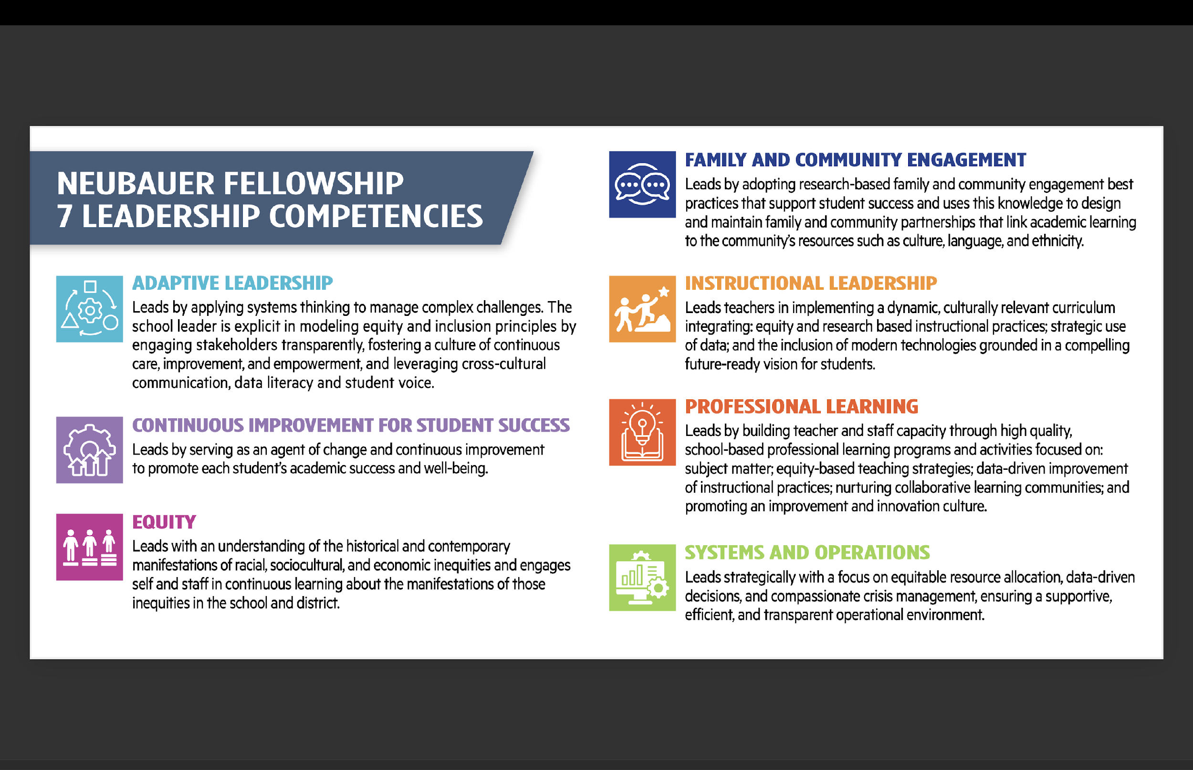
LEADERSHIP COMPETENCIES
DECEMBER 10, 2025

Slide 20
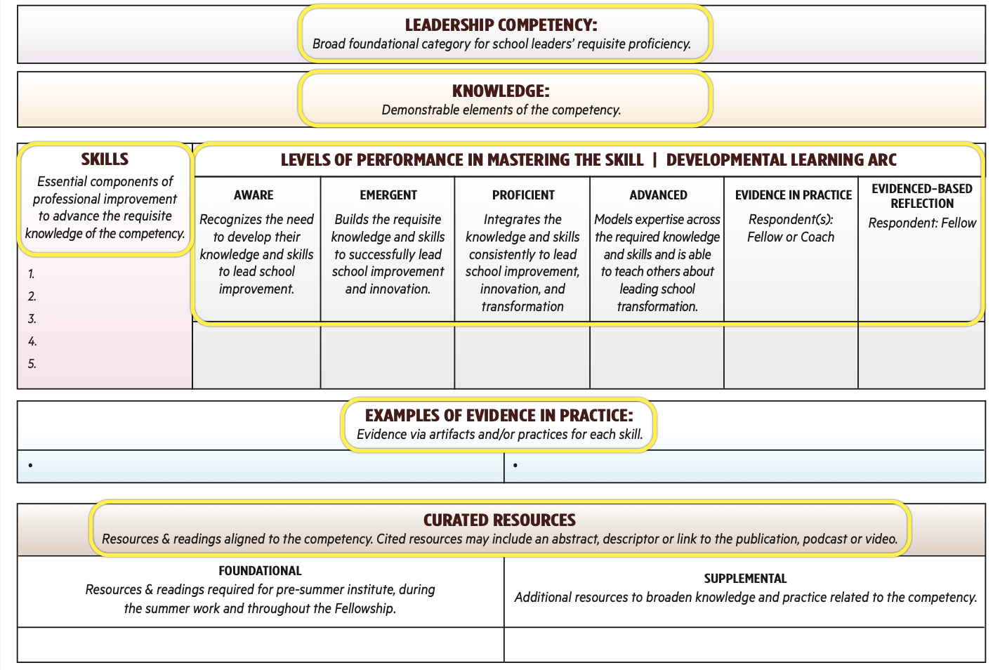
Drawn from PASL Leadership Competencies Framework for Professional Practice; 2024

Slide 21
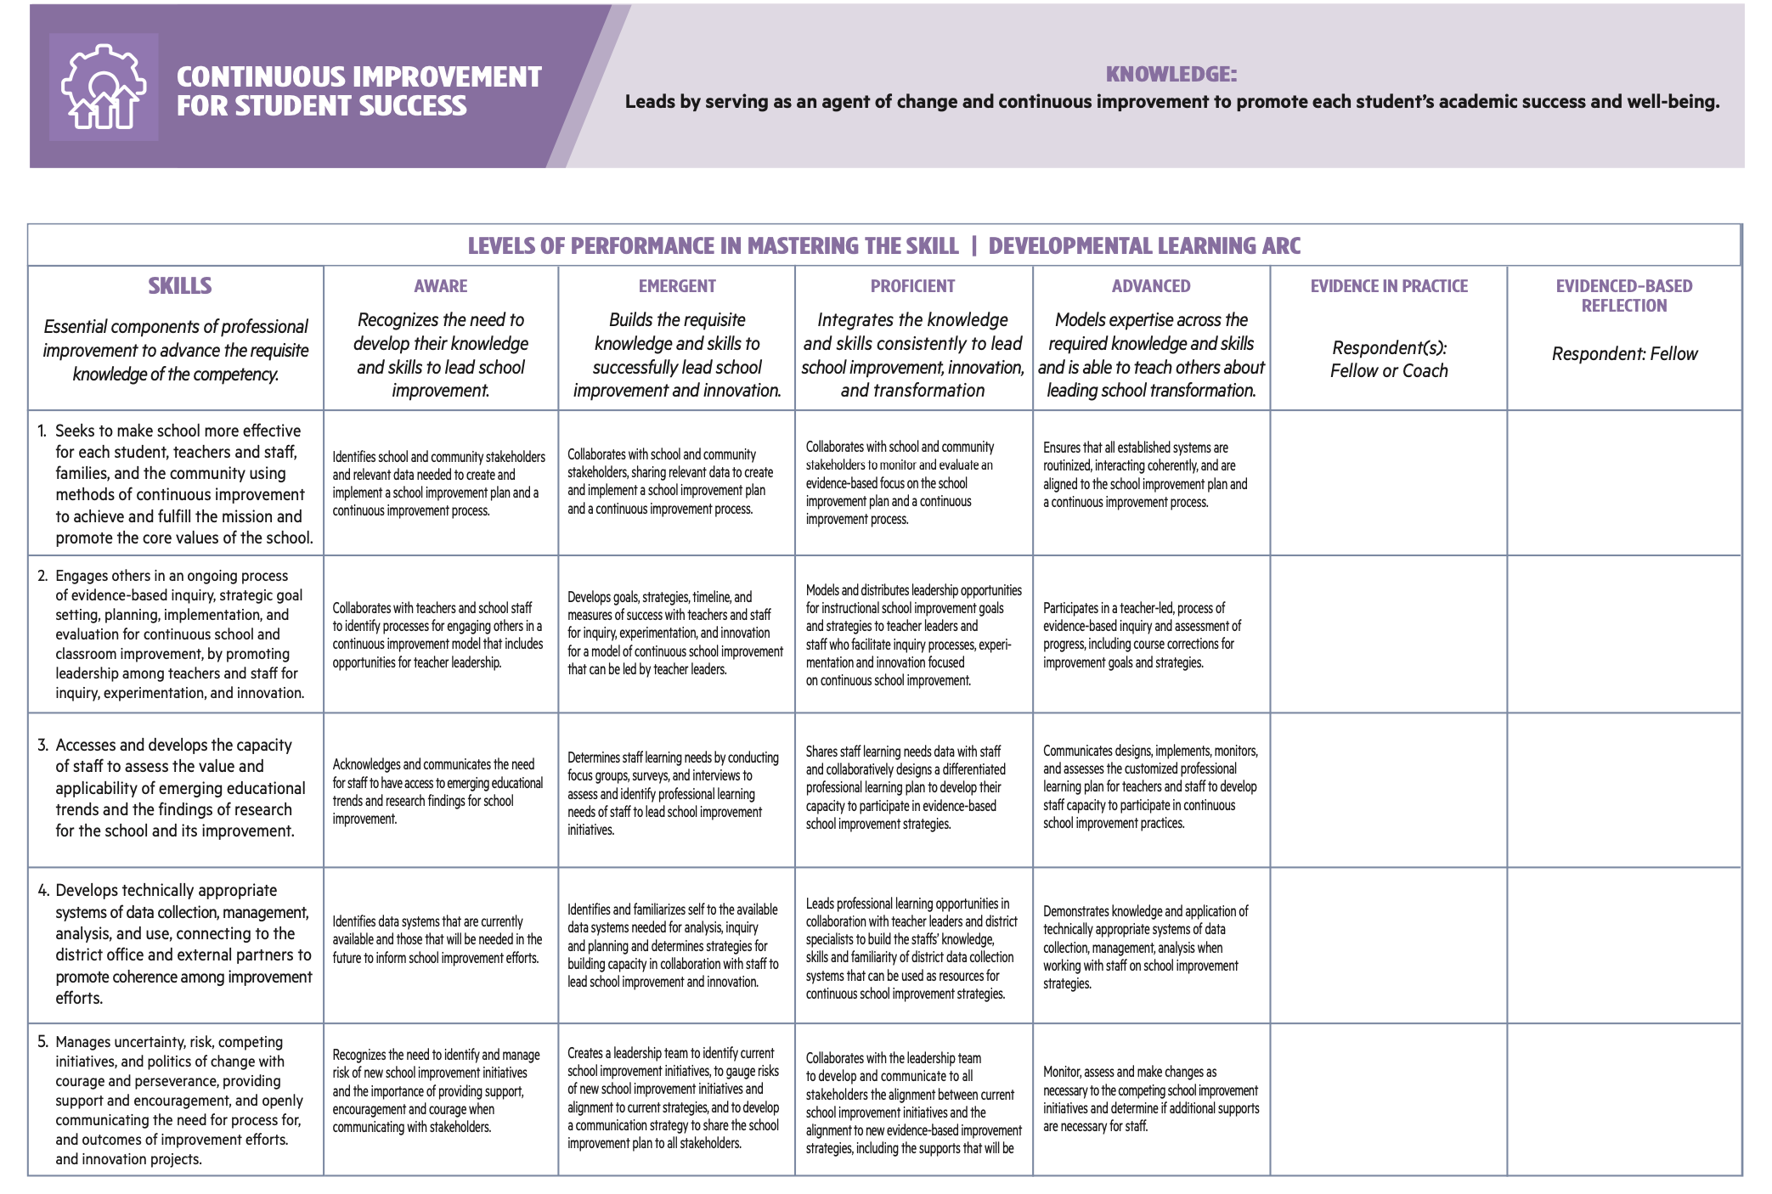
Drawn from PASL Leadership Competencies Framework for Professional Practice; 2024

Slide 22
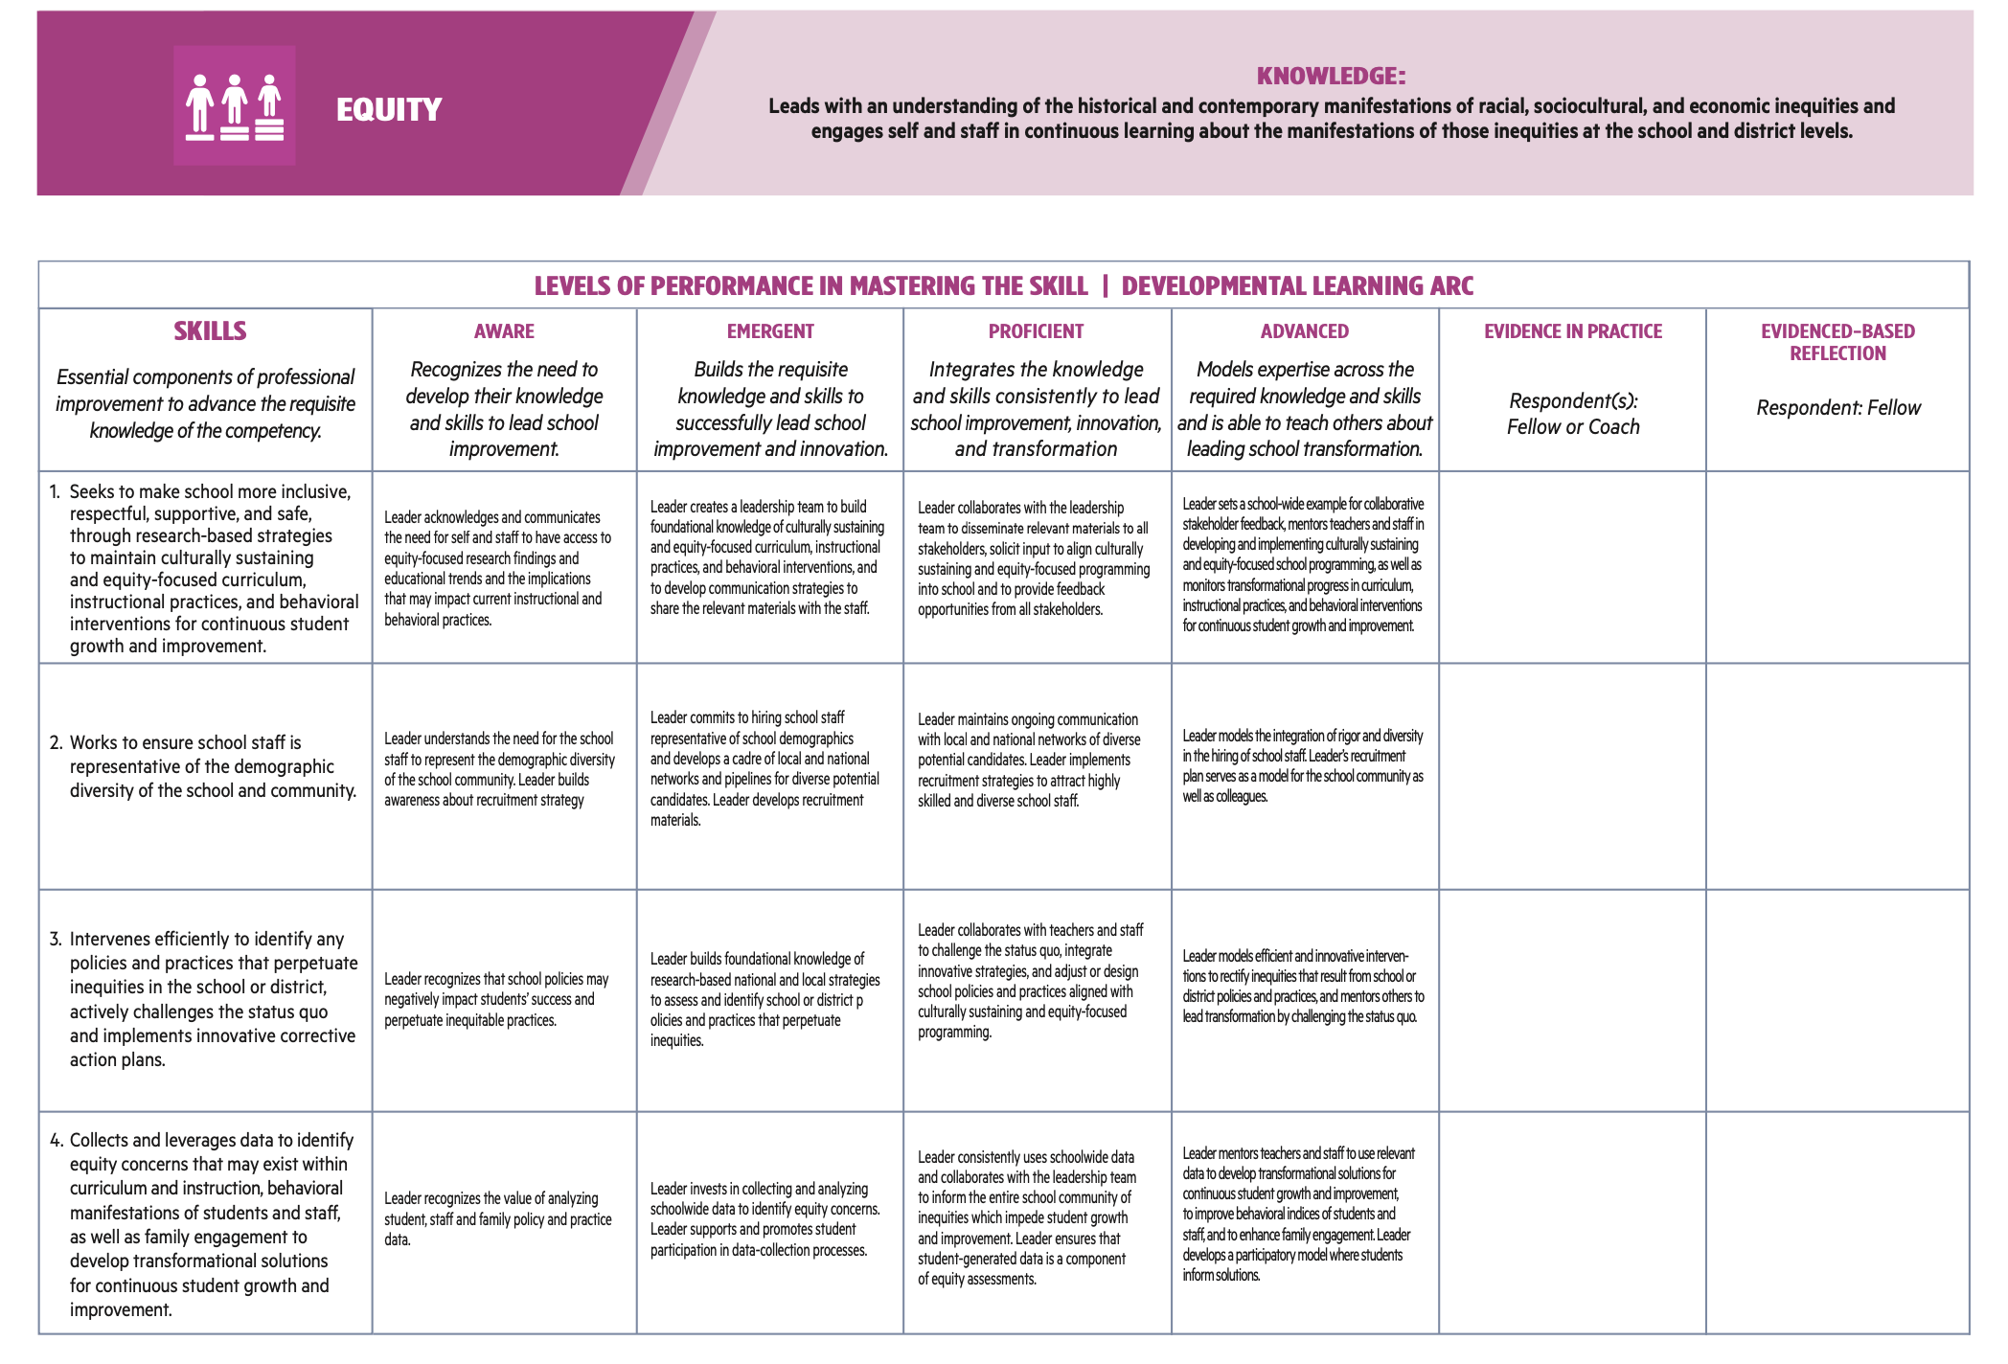

Slide 23
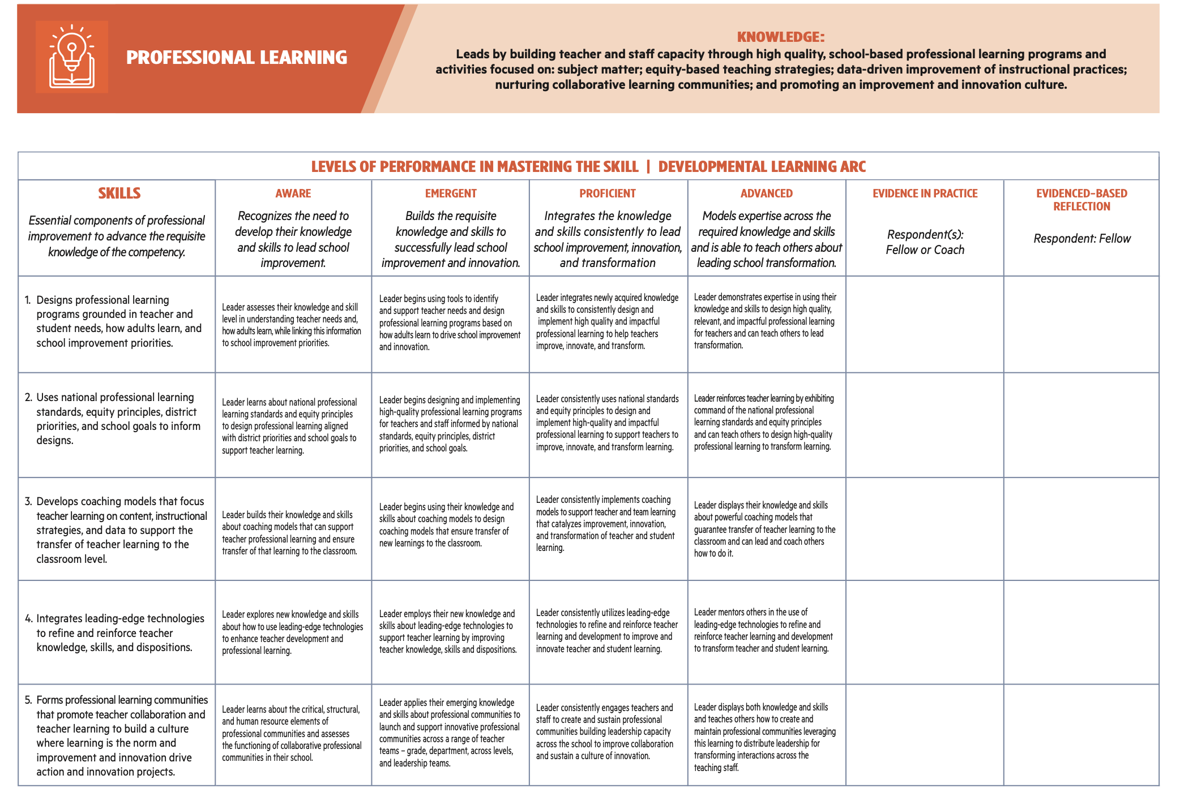

Slide 24
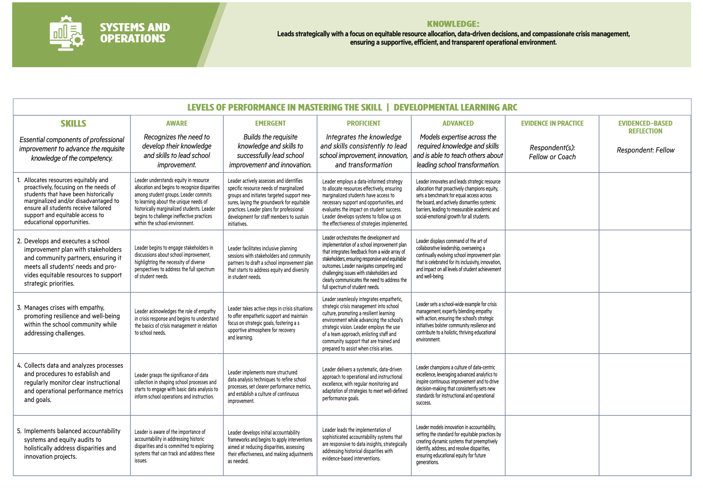

Slide 25
THE NEUBAUER FELLOWSHIP IN EDUCATIONAL LEADERSHIP
SCHOOL REFLECTIONS | NATALIE CATIN ST. LOUIS & OMAR CROWDER & MICHAEL FARRELL, EdD
Notes:
Edwin

Slide 26
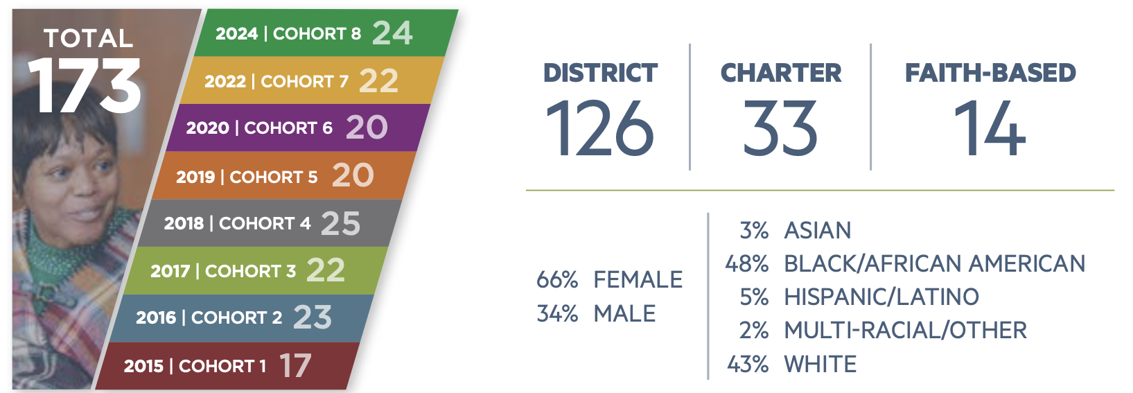
A DECADE OF IMPACT
DECEMBER 10, 2025
Notes:
Natalie + Omar

Slide 27
NEUBAUER FELLOWSHIP
8 Cohorts
A two-year cohort-based program for dedicated principals, the Neubauer Fellowship in Educational Leadership develops the critical leadership skills needed to ELEVATE SCHOOL PERFORMANCE AND ADVANCE STUDENT OUTCOMES.
173 Fellows
125 Current Principals
In Philadelphia
34 System Leaders
In Philadelphia
DECEMBER 10, 2025

Slide 28
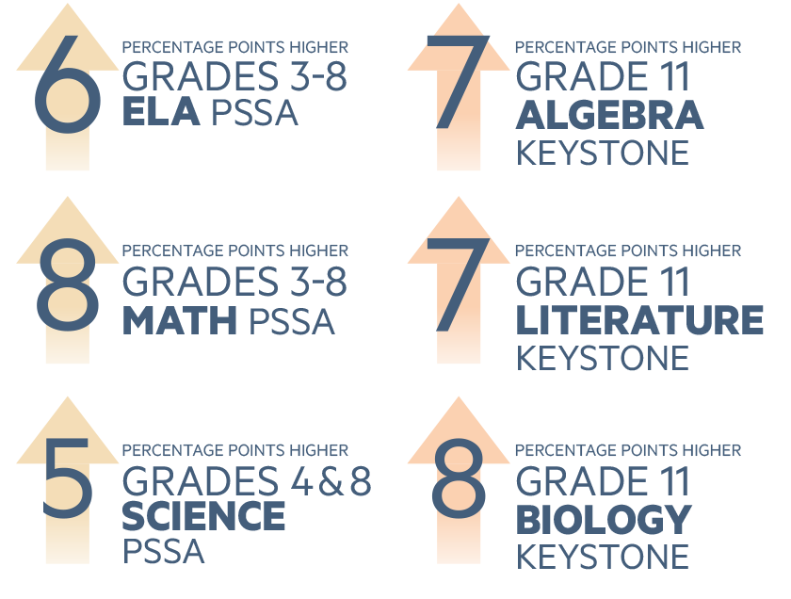
2024 STUDENT ACHIEVEMENT
In 2024, a HIGHER PERCENTAGE OF STUDENTS ATTENDING DISTRICT SCHOOLS LED BY NEUBAUER FELLOWS scored Proficient or Advances on state standardized tests—Pennsylvania System of School Assessment (PSSA) and Keystone Exams (Keystone)-–compared to schools with non-Neubauer Fellow leaders. This trend holds true for all subjects.
DECEMBER 10, 2025
Notes:
Michael

Slide 29
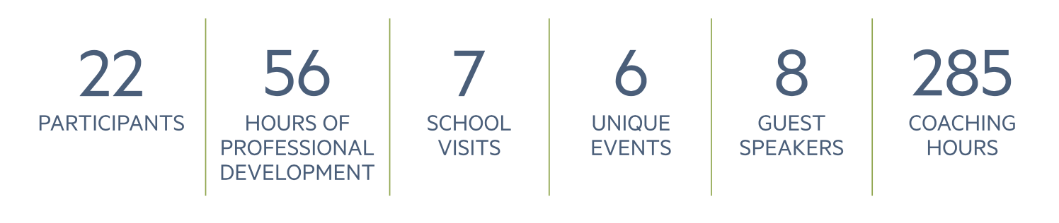

NEUBAUER FELLOWSHIP
| Cohort 7 (2023) Program Data
DECEMBER 10, 2025
Notes:
Natalie

Slide 30

NEUBAUER FELLOWSHIP
COACHING
Cohort 1 of the Fellowship was in 2015
Cohort 7 was the first to receive coaching in 2023
Coaching Guide developed to drive coaching implementation
Grounded in the “Blended Coaching” model – Bloom and Wilson; Second Edition; 2023
DECEMBER 10, 2025
Notes:
Omar

Slide 31
DEEP DIVE:
NEUBAUER FELLOWSHIP
SCHOOL REFLECTIONS
NATALIE CATIN ST. LOUIS & OMAR CROWDER
DECEMBER 10, 2025

Slide 32
NEUBAUER FELLOWSHIP | Experience & Impact

Slide 33
DEEP DIVE:
LEADER OF LEADERS
SYSTEM REFLECTIONS
MICHAEL D. FARRELL, EdD (School District Of Philadelphia) &
JACKIE O. WILSON, EdD (Executive Director, National Policy Board For Educational Administration)
DECEMBER 10, 2025

Slide 34
LEADERS OF LEADERS
WALLACE RESEARCH- SDP SELF-STUDY | Michael
PHILLY CONTEXT
Principal Supervision in Philadelphia | Michael
Accelerate Philly | Michael
FROM TINKERING TO TRANSFORMATION- MULTI-YEAR PARTNERSHIP | Michael
LEADER OF LEADERS OVERVIEW | Jackie
Coherence & Alignment | Michael
Blend Coaching | Jackie
Scope & Sequence (SY24-25) | Jackie)
Scope & Sequence (SY25-26) | Michael
Impact | Michael
DECEMBER 10, 2025

Slide 35
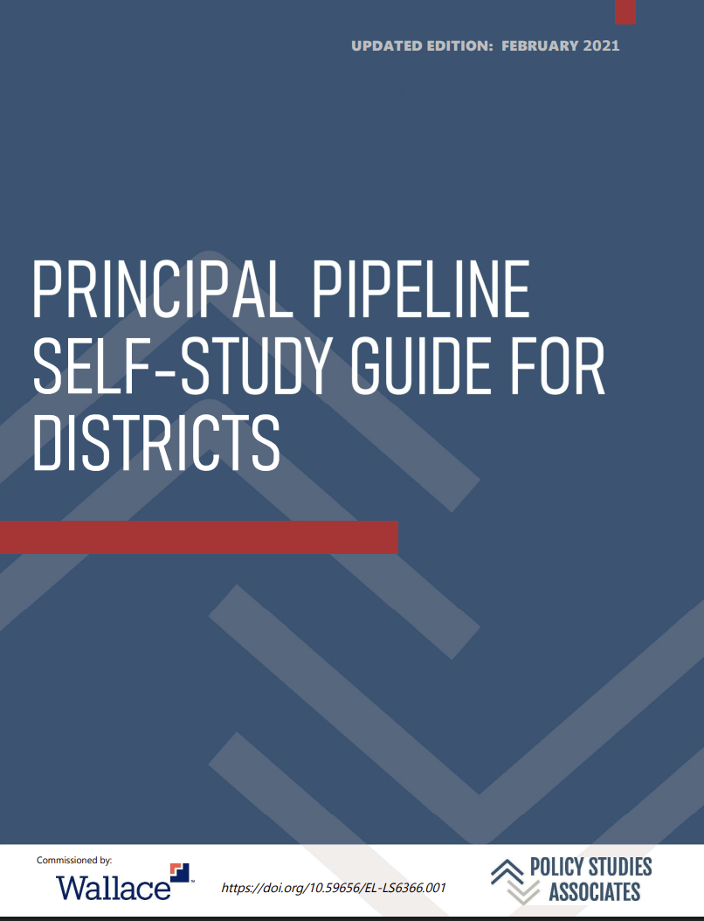
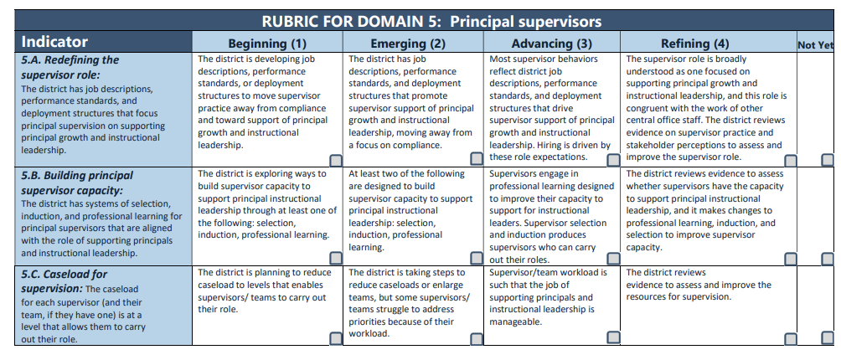
PRINCIPAL SUPERVISION
DECEMBER 10, 2025
Notes:
Michael

Slide 36
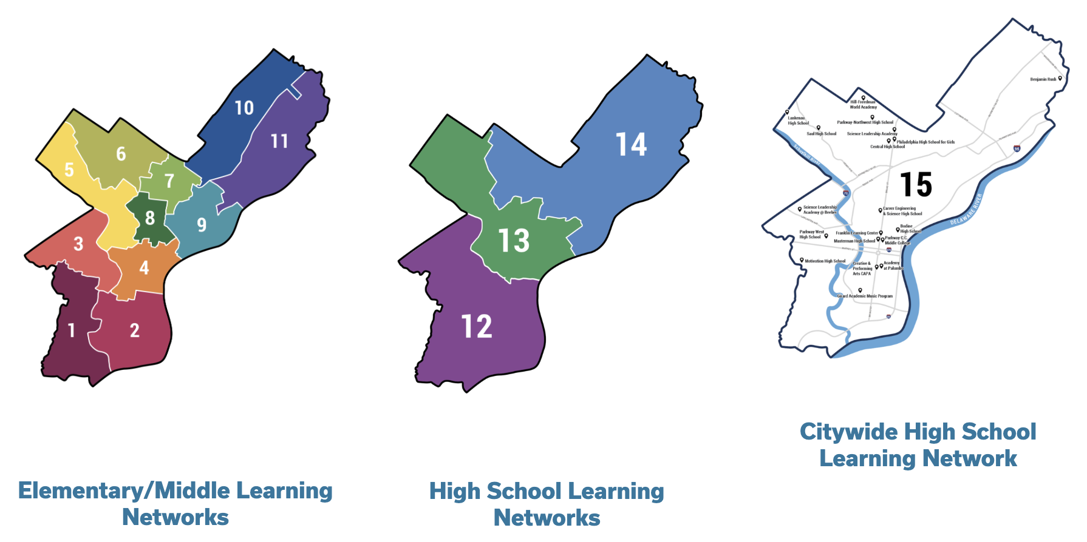
PRINCIPAL SUPERVISION IN PHILADELPHIA
Elementary/Middle Learning Networks
High School
Learning Networks
Citywide High School
Learning Networks
DECEMBER 10, 2025
Notes:
Michael

Slide 37


ACCELERATE PHILLY
DECEMBER 10, 2025
Notes:
Michael

Slide 38
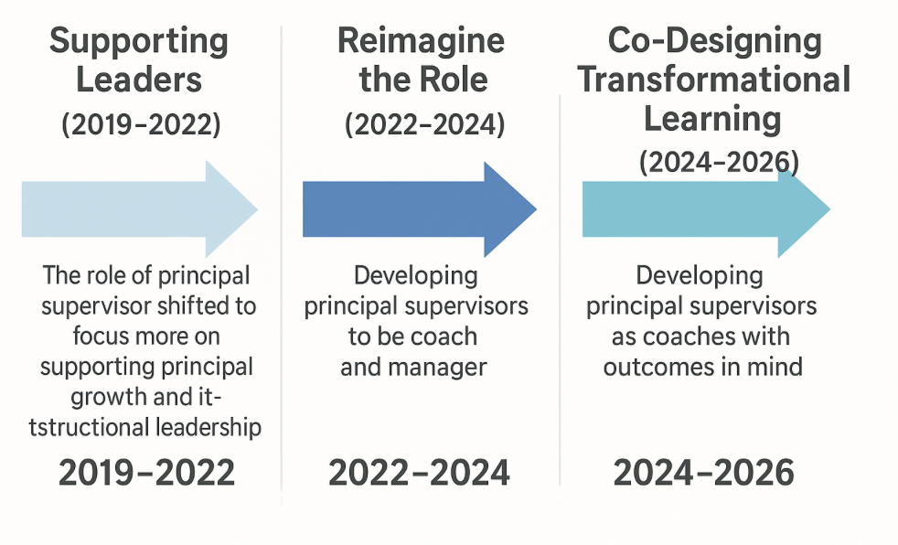
FROM TINKERING TO TRANSFORMATION
DECEMBER 10, 2025
Notes:
Use Michael’s email to update image

Slide 39

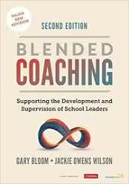

LEADERS OF LEADERS | Program Design
DECEMBER 10, 2025
Notes:
Michael

Slide 40
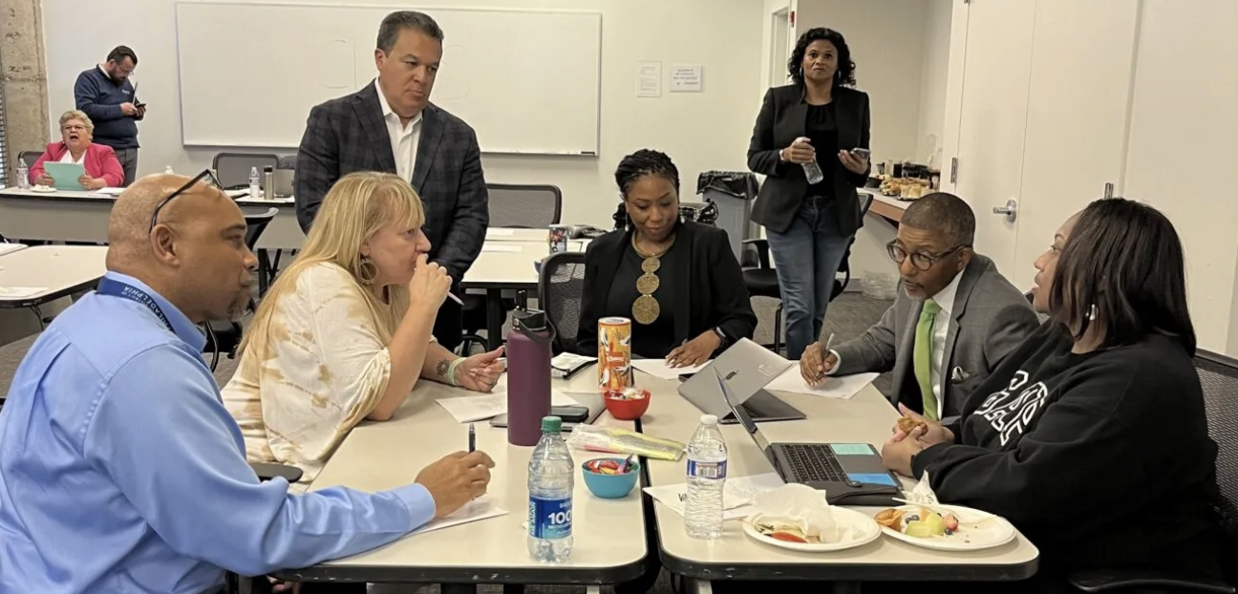
LEADERS OF LEADERS | Overview
Leverage key points from the NATIONAL PRINCIPAL SUPERVISOR STANDARDS in their own practice.
Apply BLENDED COACHING concepts to better develop school leaders within their networks
Strengthen their advisory skills surrounding INSTRUCTIONAL LEADERSHIP
Acknowledge the IMPACT PERSONAL IDENTITY can have on leadership and the coach-coachee relationship
DECEMBER 10, 2025
Notes:
Jackie

Slide 41
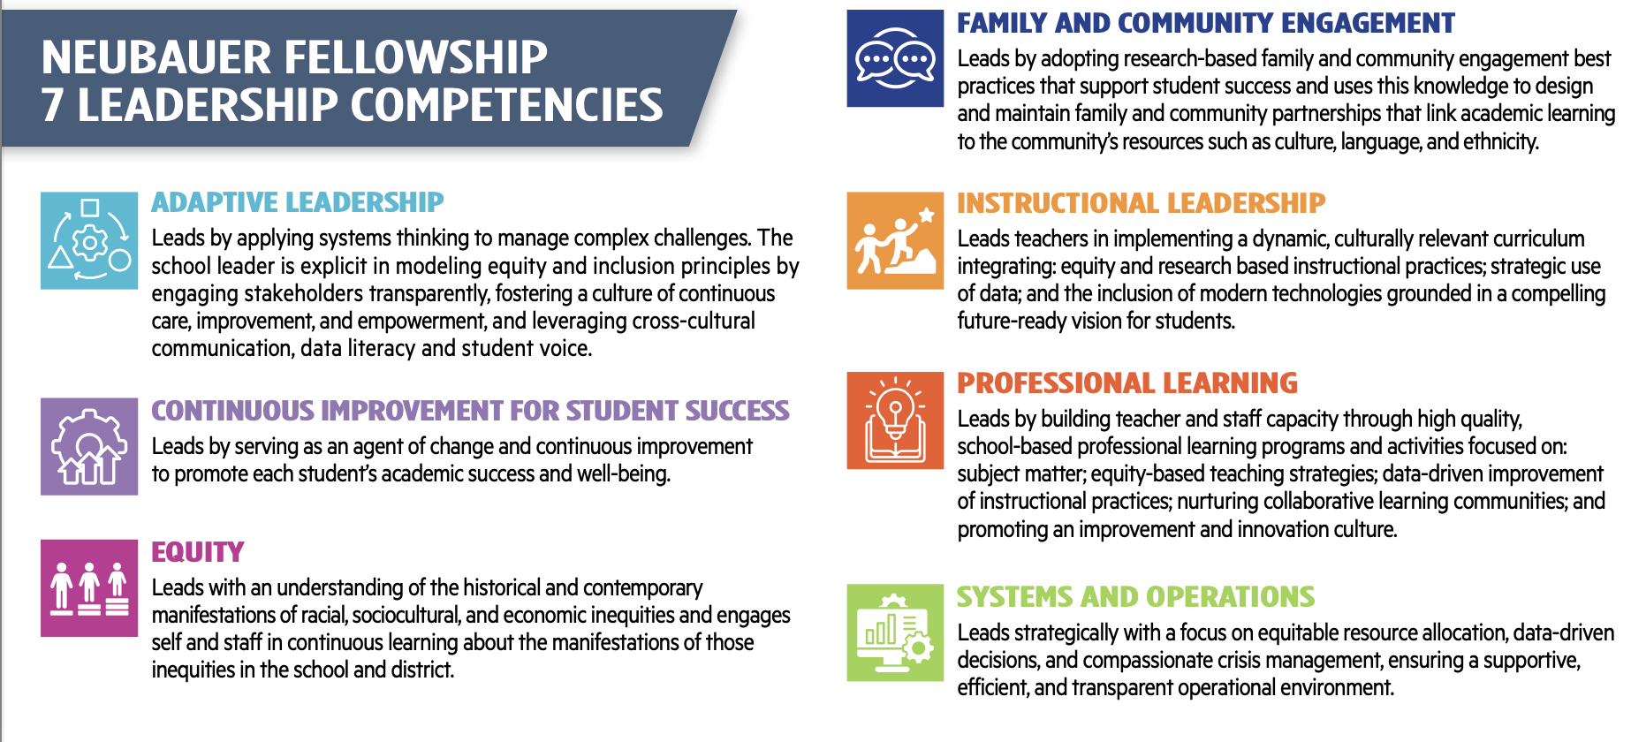
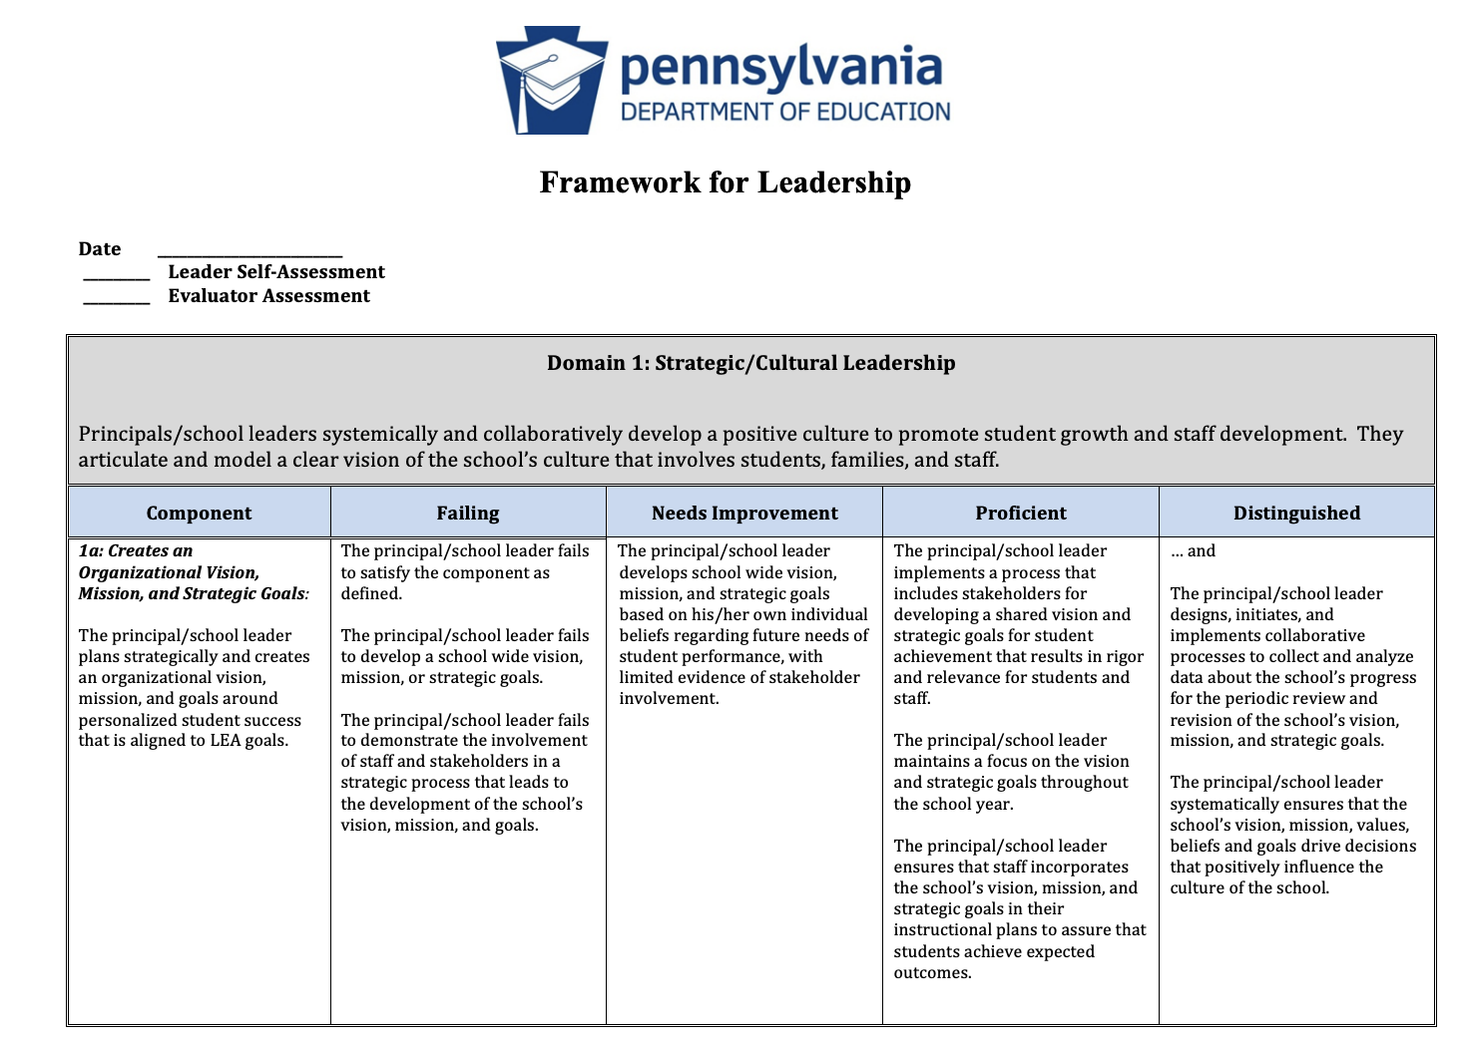
LEADER OF LEADERS WILL: ● Apply Adaptive Leadership to navigate complex challenges with transparency and trust.
● Drive Continuous Improvement by helping principals establish clear, measurable goals for student success.
● Model Equity by engaging in coaching conversations that acknowledge systemic inequities and support culturally responsive leadership.
● Strengthen Instructional Leadership by guiding principals to implement high-quality, equity-centered teaching practices.
DECEMBER 10, 2025
Notes:
Jackie

Slide 42
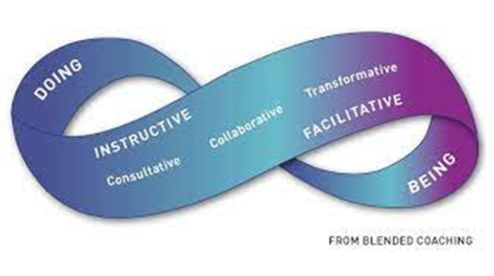
COACHING MODEL
BLENDED COACHING
Research-informed model
Experienced coaches
Required training
PSEL Aligned tools
COACHING-BASED SUPERVISION
Aligned to the Model Standards for Principal Supervisors, or
Aligned to District Performance Evacuation System for Professional Growth
Conference Planning Resources
Record Keeping Templates
Taning Materials for Coaches/Supervisors
Focus on coaching support of the school leader in mastering the profession and emotional challenges of school leadership for a meaningful and positive impact on students
DECEMBER 10, 2025
Notes:
Jackie- no coaching w/o trust

Slide 43
“We find that central office staff can do much to ensure that their daily work meaningfully supports principals as they enable teachers to help all students realize ambitious learning goals.”
“Our research and district partnerships reveal that such performance alignment entails a fundamental redesign of many central office functions, with particular attention to Curriculum and Instruction, Human Resources, and Principal Supervision. “
(HONIG & RAINEY, From Tinkering to Transformation, 2023)
DECEMBER 10, 2025
Notes:
Jackie + Michael

Slide 44
LEADERS OF LEADERS | Session Scope & Sequence
FROM FRAGMENTATION TO FOCUS: Prioritizing Impact over Supervision
FROM SUPERVISION TO COACHING: A Differentiated Approach to Improving Leadership
BLENDED COACHING AND FEEDBACK to Change Principal Practice
MAKING THE CASE for Coaching-Based Supervision
DEVELOPING A COMMON UNDERSTANDING of an Effective Principal Supervisor and What it Takes to be an Instructional Leader
COACHING ALONG LINES OF DIFFERENCE and it Impact on Relationships
DEVELOPING SYSTEMS OF GROWTH and Support for School Principals
THE END OF YEAR EVALUATION PROCESS of Principals: Challenges and Opportunities and End of Year
DECEMBER 10, 2025
Notes:
Jackie + Michael

Slide 45
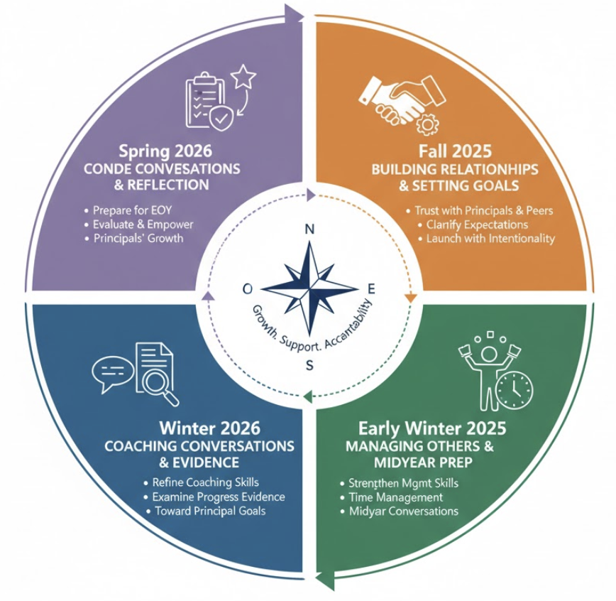
LEADERS OF LEADERS | 2025-2026
DECEMBER 10, 2025
Notes:
Jackie _ Michael

Slide 46
LEADERS OF LEADERS
“[Leaders of Leaders] has helped me be more reflective abut how I support my leaders, making sure that my questions (coaching) are empower and support them in being reflective of their own practice.”
Anh Nguyen
Learning Network 15, Opportunity Network Leaders
School District of Philadelphia
DECEMBER 10, 2025

Slide 47
CLOSING
SENIOR FELLOWS
DECEMBER 10, 2025

Slide 48
PASL TEAM
PASL BOARD OF DIRECTORS & BOARD DESIGNEE
Joseph Neubauer, Board Chair – Former CEO and Chairman Aramark Corporation
Stephanie Naidoff, Esq. Former Philadelphia Director of Commerce
Tim O’Shaughnessy Senior Vice-President – Aramark U.S. Foods and Facilities
Noah Tennant, Assistant Superintendent – School District of Philadelphia
Gwenyth Gaul – Leading Strategic Partnerships & Philanthropy, Comcast NBCUniversal
Rebecca Cornejo, Executive Director – Neubauer Family Foundation
PASL ADVISORY SYSTEMS PARTNERS
Achievement Network (Anet)
Consortium for Policy Research in Education (CPRE)
Evaluation Analytics
Evaluation Advisory Panel
Insight Education Group
National Policy Board for Educational Administration
Neubauer Senior Fellows Practitioners Advisory Committee
Systems Partners
DECEMBER 10, 2025

Slide 49

ANNUAL REPORT
https://pasl.org/2024-pasl-annual-report/
DECEMBER 10, 2025

Slide 50

LEADERSHIP COMPETENCIES
https://mail.google.com/mail/u/0/#search/edwin%40pasl.org/FMfcgzQcqlBMZKVTVlCTZwRHSwKmmdvd?projector=1&messagePartId=0.4
DECEMBER 10, 2025

Slide 51

COACHING BLUEPRINT
https://mail.google.com/mail/u/0/#search/edwin%40pasl.org/FMfcgzQcqlBMZKVTVlCTZwRHSwKmmdvd?projector=1&messagePartId=0.3x
DECEMBER 10, 2025

Slide 52
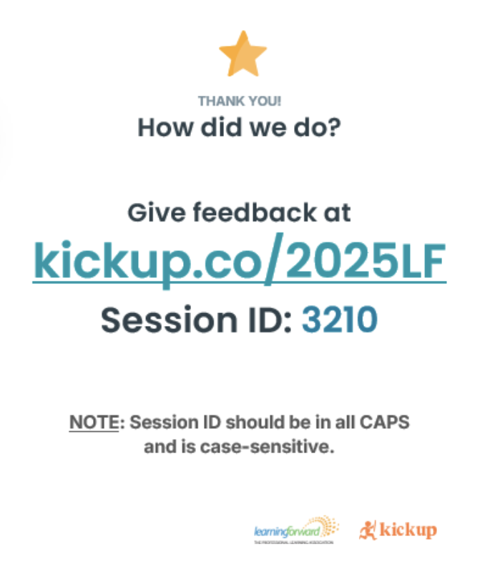
Thank you for joining us for this session showcasing the Philadelphia Academy of School Leaders at Learning Forward
Learning Forward | Boston, 2025
DECEMBER 10, 2025

