Slide 1
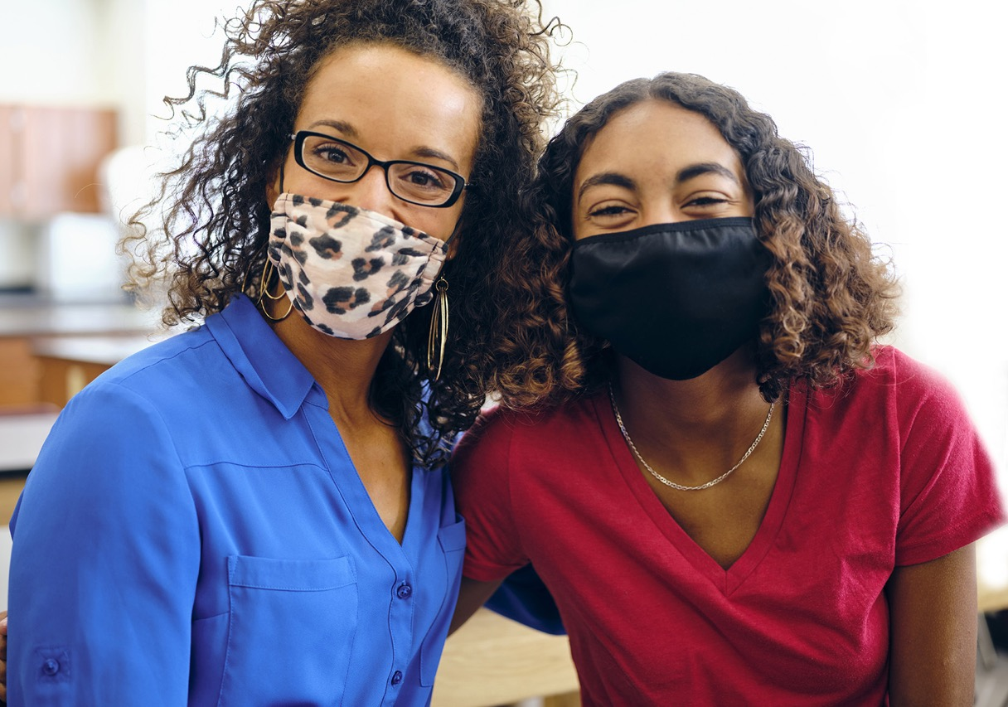
Celebrating
Educators:
Acknowledge, Honor, Energize, and Renew
Webinar
May 6, 2021
Welcome! We will begin shortly.
If you can see the
slide and hear the
music, you are all set.
All attendees are muted upon entry.
Please use the chat feature for comments
and questions during the webinar.
www.learningforward.org
1

Slide 2

Thank you for joining us
The webinar
will be recorded and available.
All webinar registrants will receive a follow-
up email that
will include the webinar slide deck, recording, and
other resources mentioned during the presentation.
Please introduce yourselves in the chat box
Your name
Your location
Your role in the educational sector
@learningforward

Slide 3
Participants will …
Learn innovative, tangible ways to celebrate educators
Understand the importance of gratitude and acknowledgment
Consider efforts needed now to reenergize for the school year ahead
Share their own experiences and ideas

Slide 4
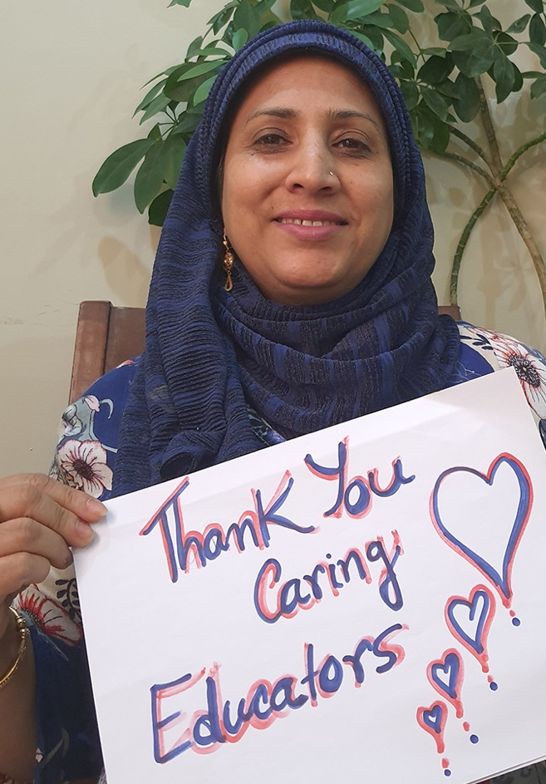
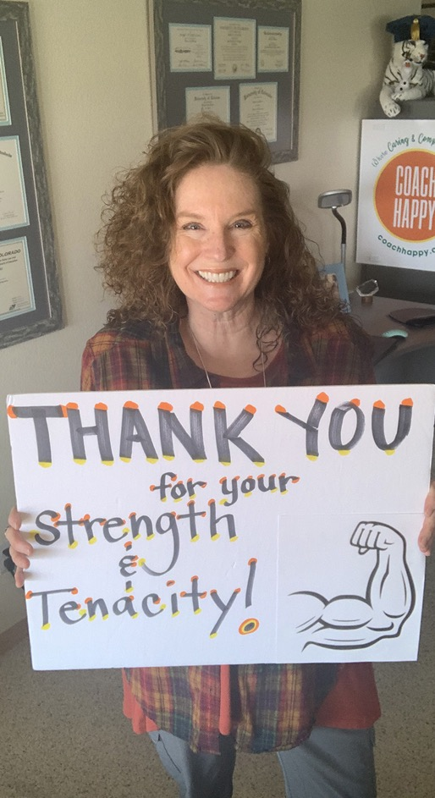
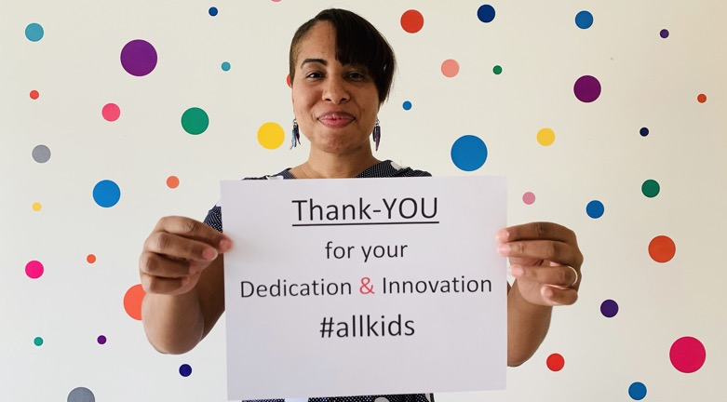
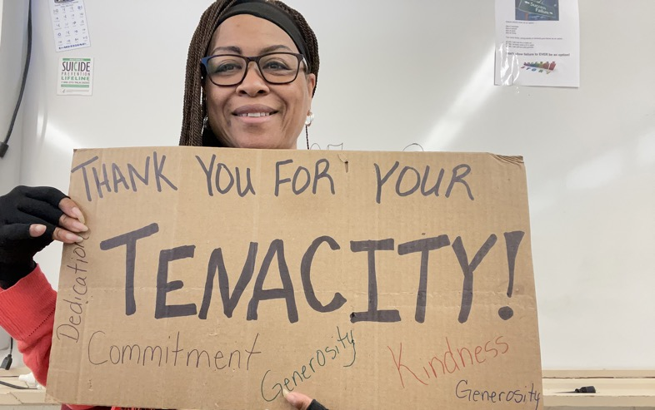
Happy Teacher Appreciation Week!

Slide 5
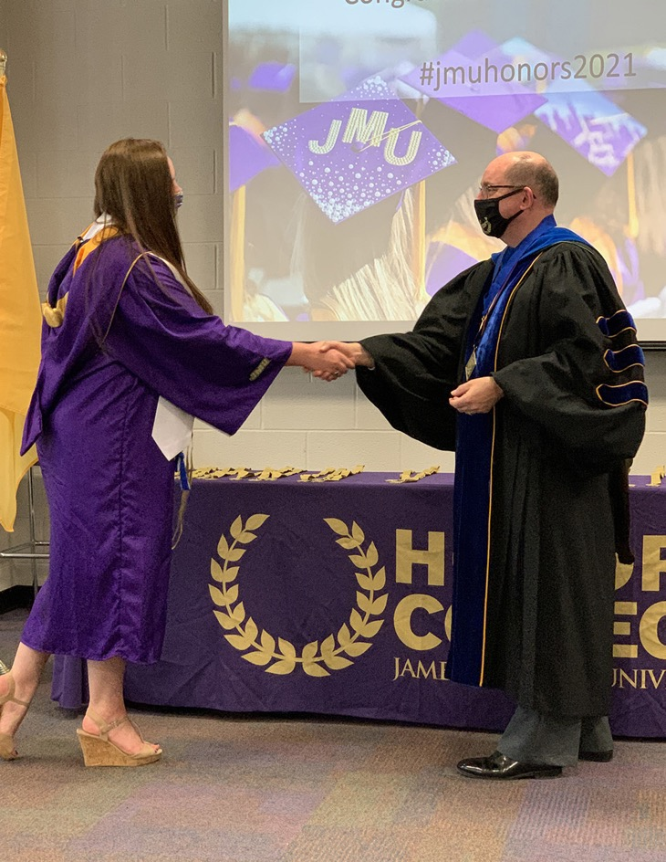
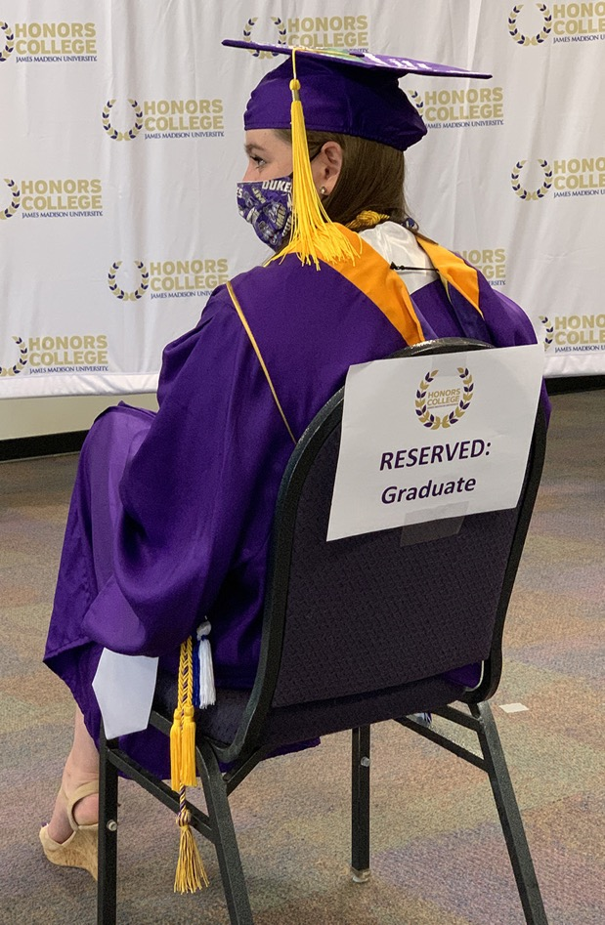
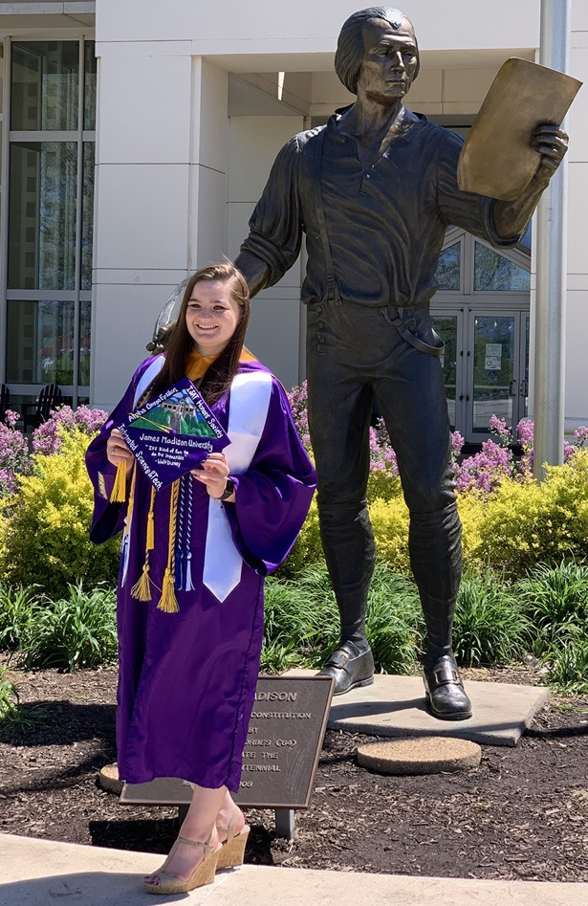
Making it count

Slide 6
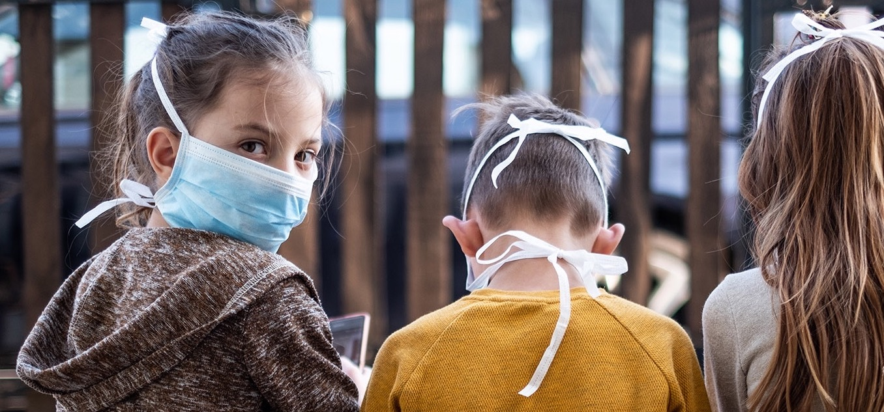

When you think about last school year . . .
“What’s it
like being
the teacher
of the worst
year ever?”

Slide 7
Opportunity to reflect and share
In the chat box, please write one way in which you have been celebrated or celebrated another colleague.
If you are willing to share a resource that you rely on, please include a title and link in the chat box.

Slide 8

A deep dive…

Slide 9
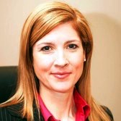
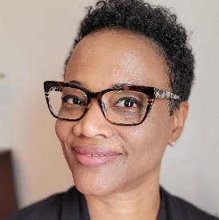
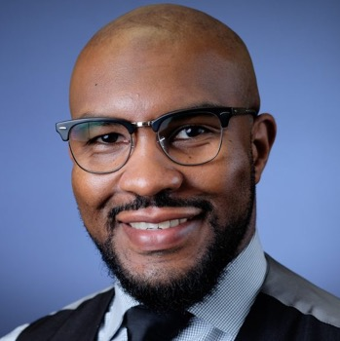
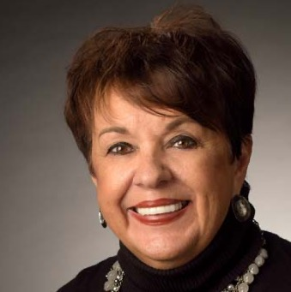
Panel discussion
Heather Lageman
Acting Chief of Organizational Effectiveness
and Executive Director
of Leadership & Organizational Development
Baltimore County Public Schools
Towson, MD
Angela Booze
Resource Teacher
Office of Professional Learning
Baltimore County Public Schools
Towson, MD
Aubrey P. Brown, Jr.
Principal
Randallstown High School
Randallstown, MD
Deborah S. Phelps
Executive Director
The Education Foundation of Baltimore County Public Schools, Inc.
Towson, MD

Slide 10
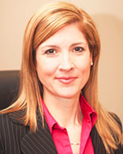
Heather Lageman
Acting Chief of Organizational Effectiveness
Baltimore County Public Schools
Baltimore County, Maryland
Email: Hlageman@bcps.org
www.linkedin.com/in/heather-lageman-8b059341

Slide 11

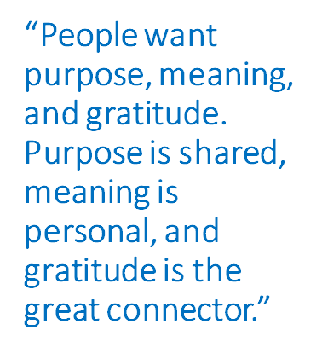
Celebrating educators: Acknowledge, honor, energize and renew
Notes:
Heather
The month of May is dedicated to showing appreciation for educators, so it is a fitting time to dive deeply into true gratitude. Author Eric Mosley’s research shows that social recognition is the most powerful when it comes from peers. If a colleague gives a colleague a “thank you moment,”, it is a truly authentic moment because that peer did not have to do that. They were simply inspired by the work that that person exhibited, and they wanted to say, “Thank you.” It is a human moment that matters for those two individuals. And so the thanking, in that instance when it comes from peers, lifts the giver, the giver is almost changed.
By giving that gratitude, mindsets are changed. The receiver feels great because they did some good work, and now they feel like they were seen, somebody appreciated it, that’s wonderful. And the relationship between the two of them is deepened because now they have an authentic, honest moment of shared respect and appreciation.
So let’s each take this moment to thank a colleague on this webinar. Sometime during our time together, please send your gratitude to them in a text, email, or the chat. Let’s amplify our gratitude for one another, deepen our relationships, and lift each other as we move through every day.
Brene Brown - Eric Mosley Podcast: https://open.spotify.com/episode/2lrHMtKQQtJECVWcDSuudd?si=7691e982e796446e
Creating a More Human Workplace | Workhuman

Slide 12

Notes:
Heather
And here are some amazing resources you can use to create joy and send affirmation...
As Eric Mosley's research shows, it is important to be specific in our celebrations and acknowledgements.
Angela Maiers' “You Matter Manifesto” has 8 tenets and we've shared the cards in the resources you will receive after the webinar. Select one that speaks to you and send one electronically or in the mail with some specific words about something you have noticed about that person. Let's make share how they are a light in the world! http://www.choose2matter.org/manifesto-2/
The other resource on this slide is from Happy YOUniversity – a place I'd like to have graduated from! Sara and Erin are the amazing creators of this space and they focus on helping educators and leaders find their spark, become more resilient, feel empowered, positive, and connected. And I believe Erin is joining us today! Most recently, Happy YOUniversity has been working on the "dropping joy" resource on this slide and using it to inspire kindness in your community. JOY begins with you. Start by spreading a drop of JOY to an unsuspecting person and inspire them to pass it on by leaving the Joy Drop card. Joy Drop | HYOUniversity
When Amanda Gorman, the nation's first-ever youth poet laureate, shared that her new book is “the words the world needed to hear and I needed to write,” it really resonated with me and the journey this year. She created a language to talk about the full expanse of the human experience both with honesty and hope. In her poem, “The Hill We Climb,” she says
The new dawn balloons as we free it.
For there is always light, if only we’re brave enough to see it.
If only we’re brave enough to be it.
These tools enable us to be the light and the waterfall of kindness and connection in our world!
https://www.cnbc.com/2021/01/20/amanda-gormans-inaugural-poem-the-hill-we-climb-full-text.html

Slide 13

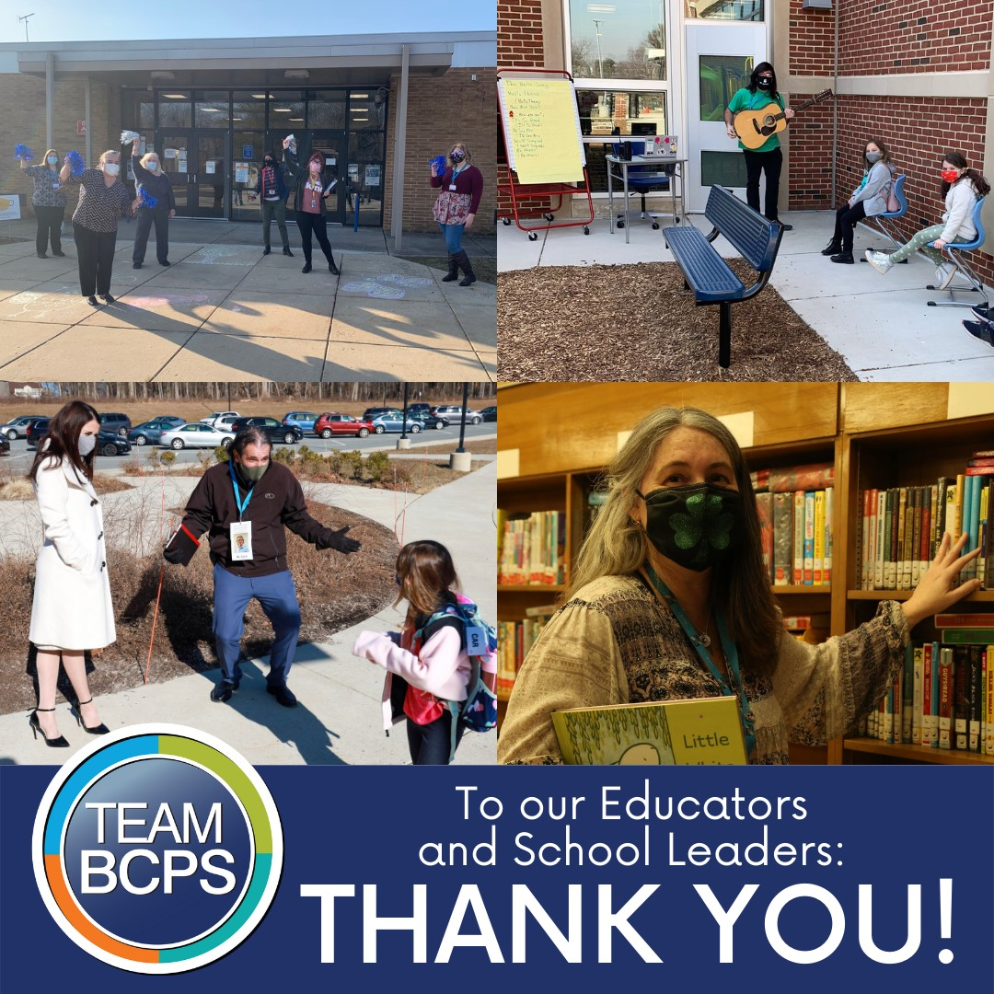
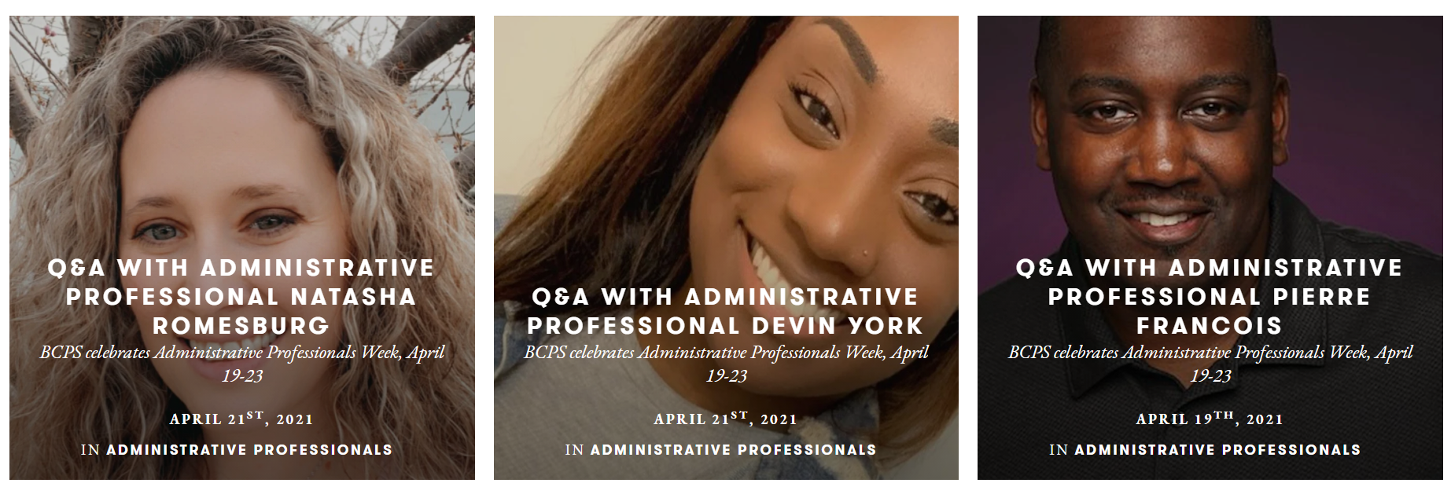
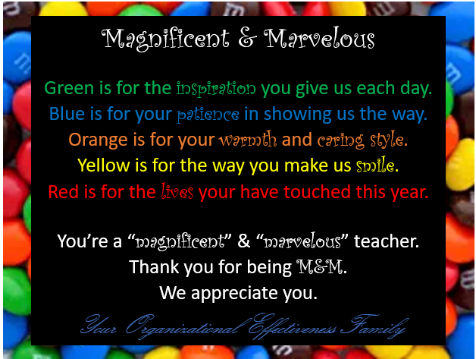
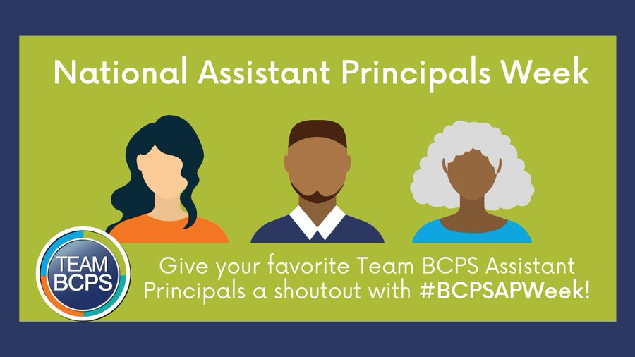

BCPS Appreciates & Celebrates!
Notes:
Heather
In BCPS, our Superintendent, Dr. Darryl Williams, is always encouraging us to live our core values, celebrate the "small wins," recognize others and build relationships. In the resources, we've included the M&M (magnificent and marvelous) template you can use to customize for your educators and leaders, as well as some other ideas for celebrating in divisions and systemwide.
One tool that our amazing Communications Team uses to tell our stories and acknowledge Team BCPS is Exposure – a modern publishing platform for photographers and visual storytellers. It’s the simple way to create and share your unique photo stories.
Create a Home for Your Stories - Exposure and we are sharing some samples with you.
Administrative Professionals Week Team BCPS - Administrative Professionals - Exposure
Assistant Principals Week Assistant Principals 101: by Team BCPS - Team BCPS - Exposure

Slide 14




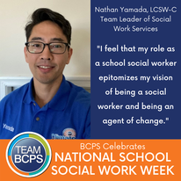


BCPS Appreciates & Celebrates!
Notes:
Heather
And here are some examples of additional ways that Team BCPS acknowledges and celebrates in divisions and systemwide using social media and our system website banner.
And now I'm thrilled to transition to Aubrey Brown, Principal of Randallstown High School – celebration, gratitude and joy are his middle names, and he is going to share a bit about how he leads with positivity and shared humanity at the center of everything he does...he "drops joy" to everyone he meets!

Slide 15
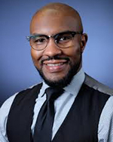
Aubrey P. Brown, Jr.
Principal
Randallstown High School
Baltimore County, Maryland
Email: abrown23@bcps.org
Instagram & Twitter:
@cre8tiveduc8or

Slide 16
“Find the good and praise it.”-Alex Haley
At RHS, we believe that gratitude and celebration...
must be meaningful.
is meaningful if (and only if) it is aligned to purpose and mission.
should be planned and public.
Notes:
Introduce our approach to celebration and gratitude

Slide 17
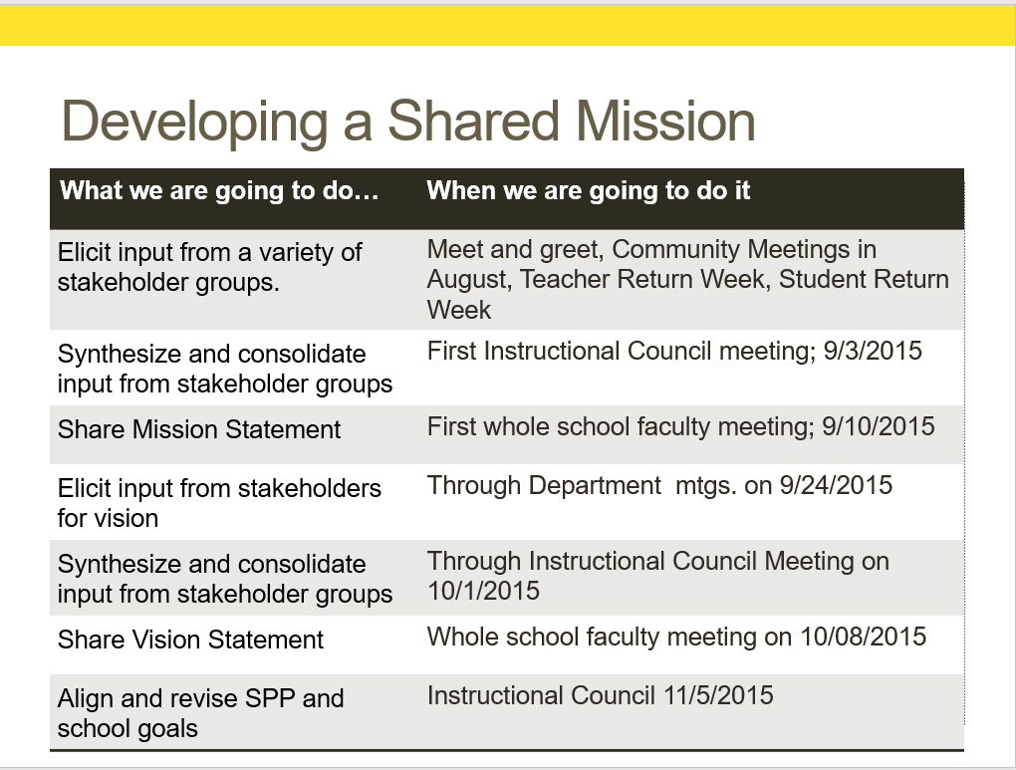
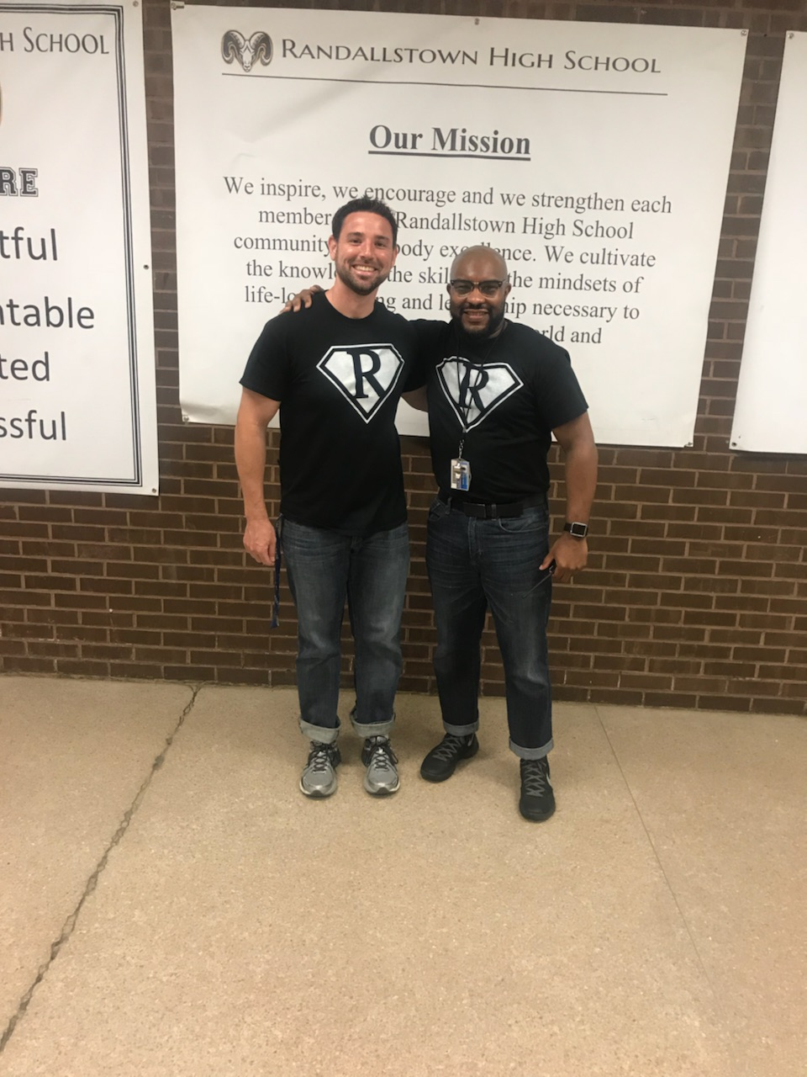
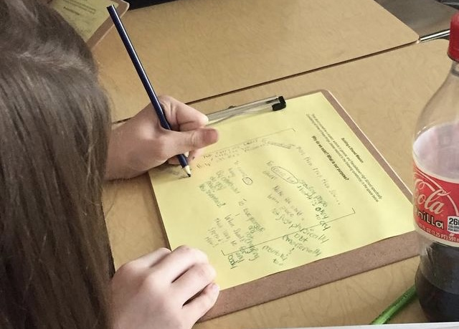
Align Joy and Gratitude to Mission and Purpose.
Respect teachers, leaders and staff input into the mission and vision.
Calendar time and use protocols to engage teachers in sense and connection making
Make the thinking, discussion and writing work around the mission and vision visible– use it!
Notes:
Gratitude and celebration is meaningful when it is aligned to the purpose and mission. Now more then ever, honoring teacher voice in the evolution of the school’s purpose and mission is the foundation for meaningful gratitude and celebration. (tools for involving teachers in the mission)

Slide 18
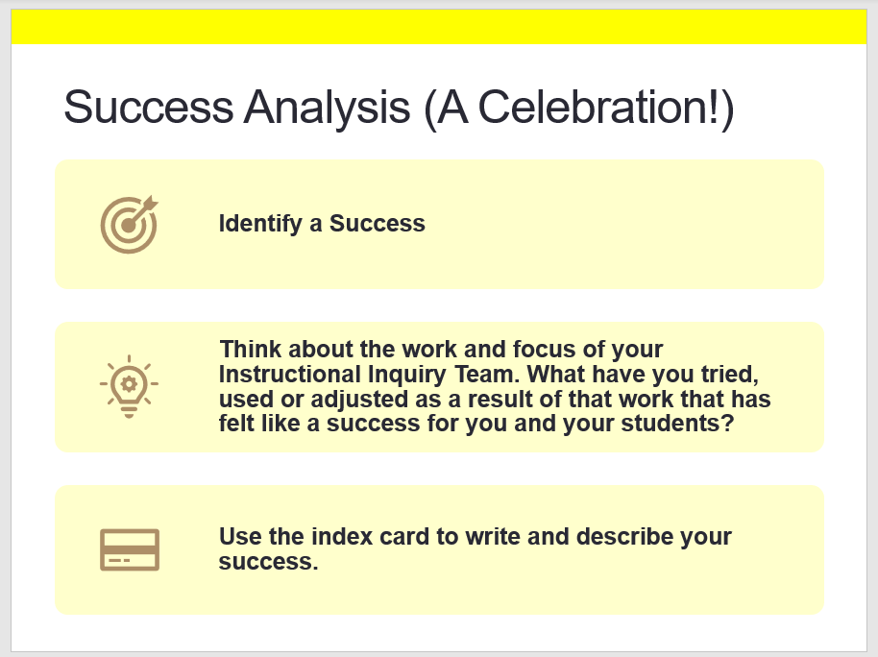

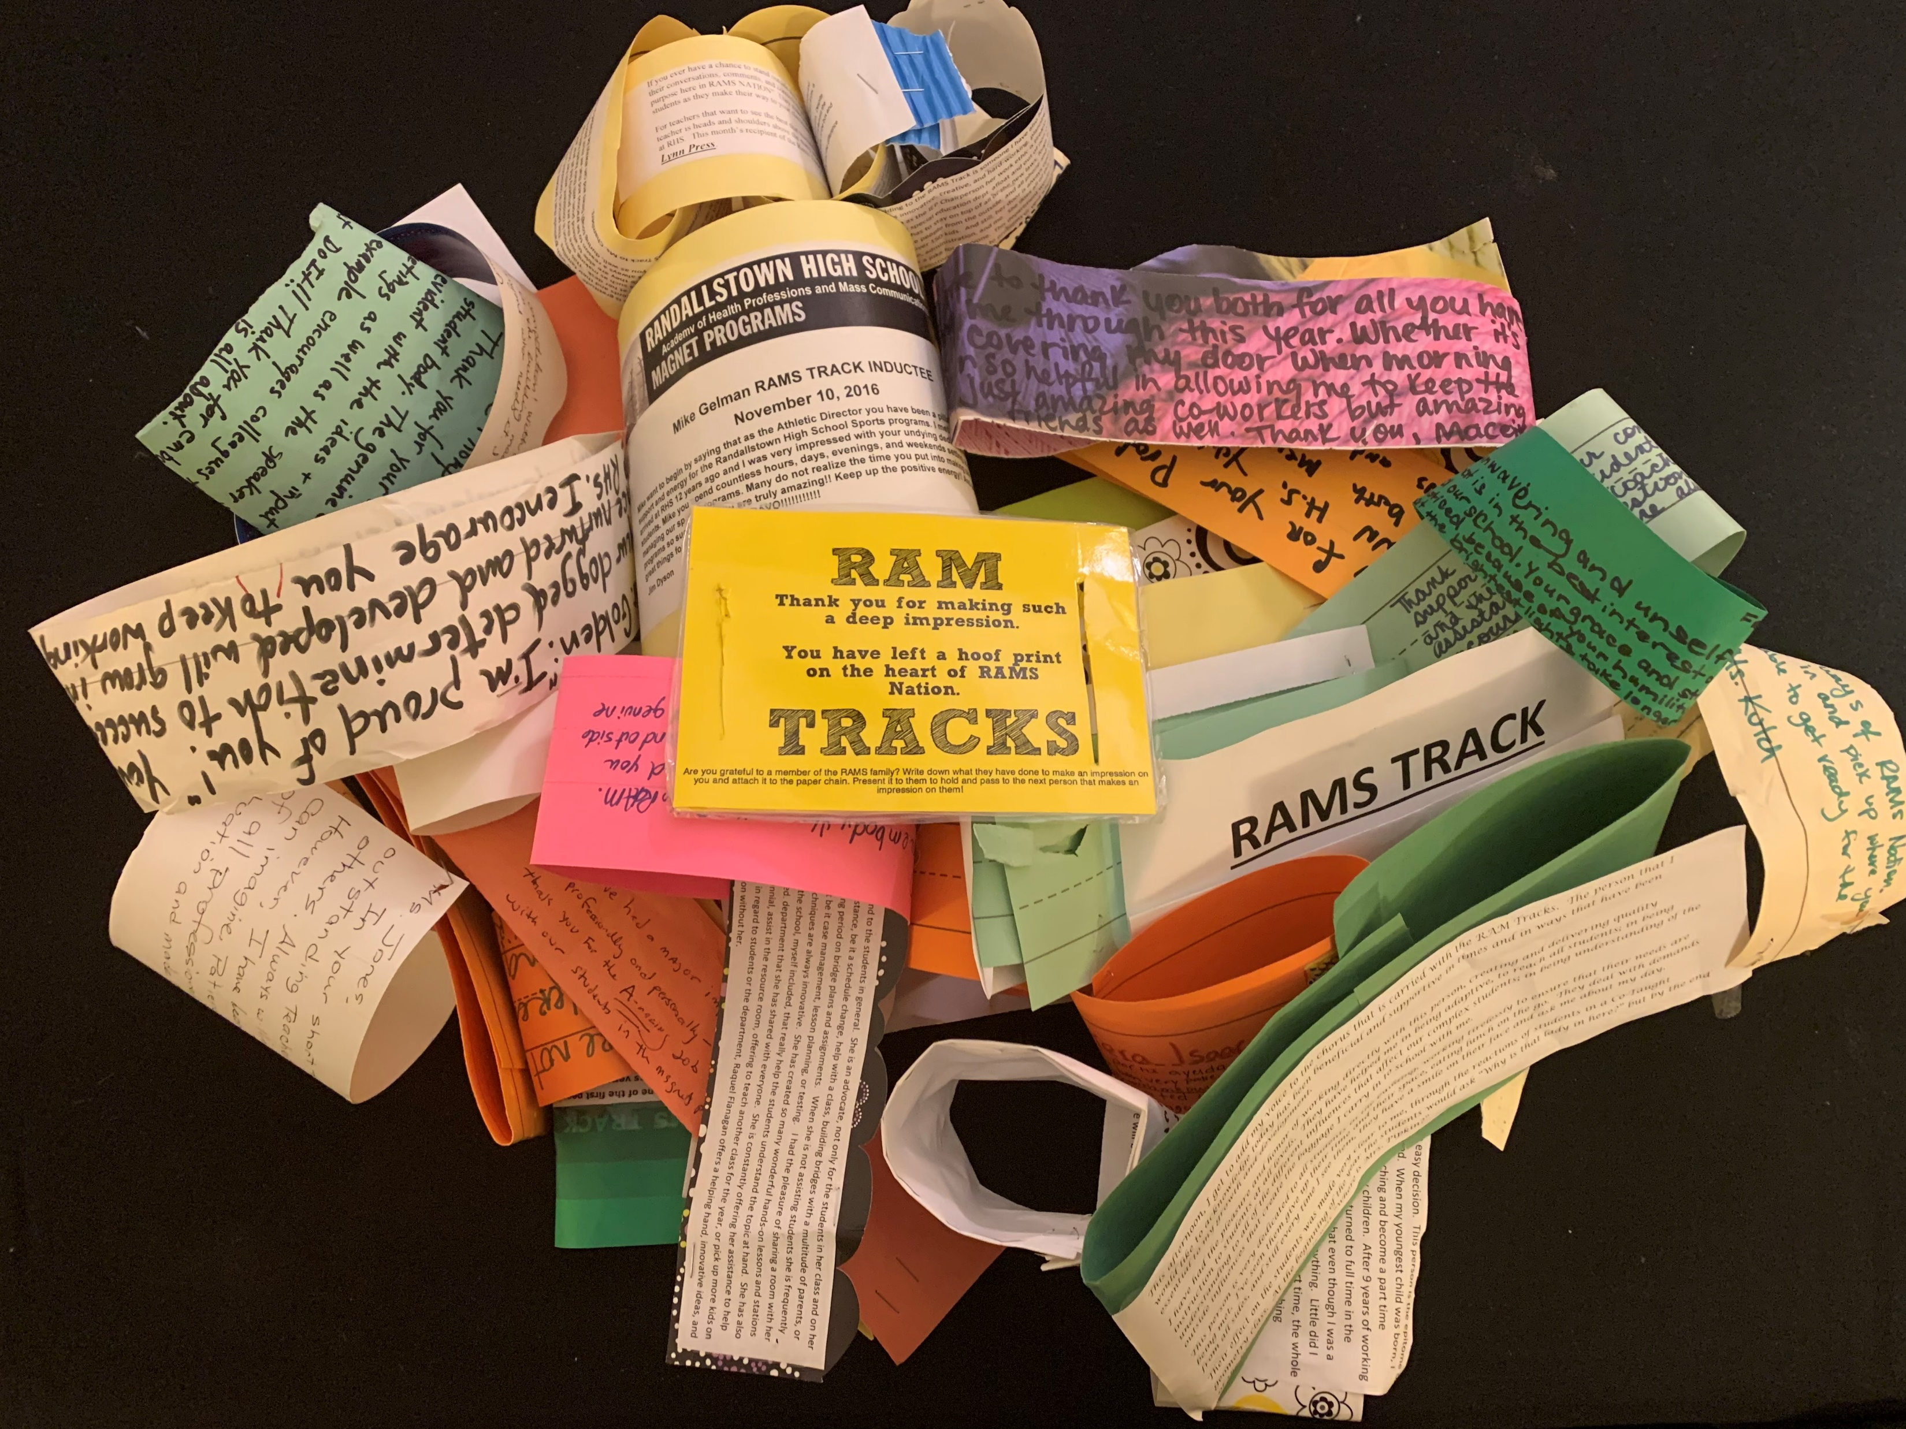
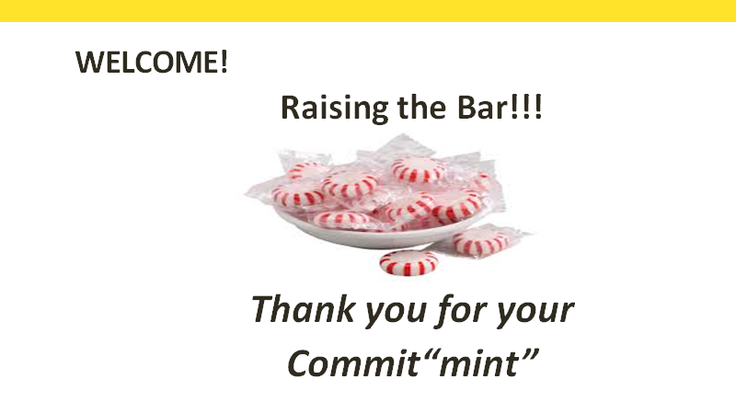

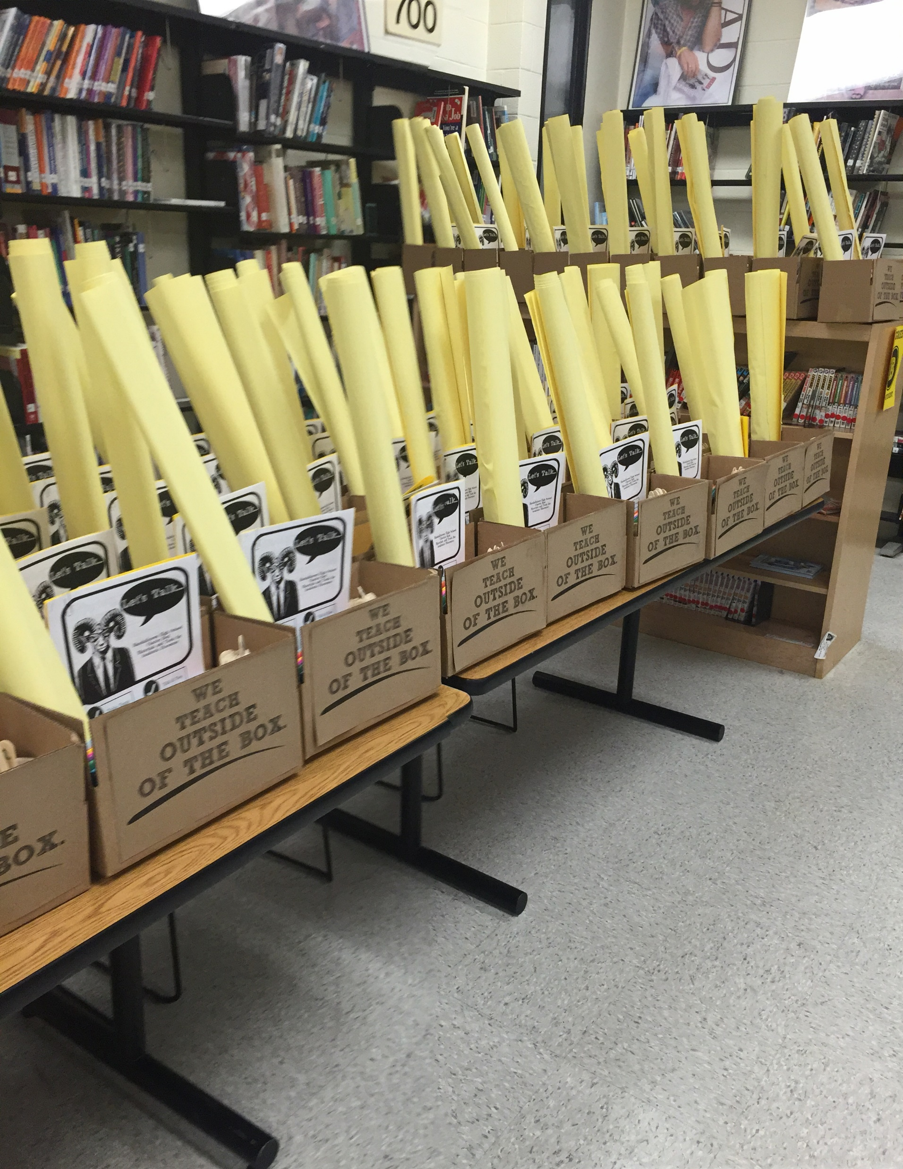
Create Symbols and Routines for Gratitude and Celebration
Let teachers know you see the work that matters most.
Notes:
Build routines that make naming and honoring work aligned to the mission/purpose a regular and consistent part of meeting together, and in communication. Empower staff to use the symbols and routines to magnify gratitude by thanking each other. Be clear about naming what it is your are celebrating– precise praise is important for students, it is also important for adults. It lets them know you truly see what they are doing.

Slide 19
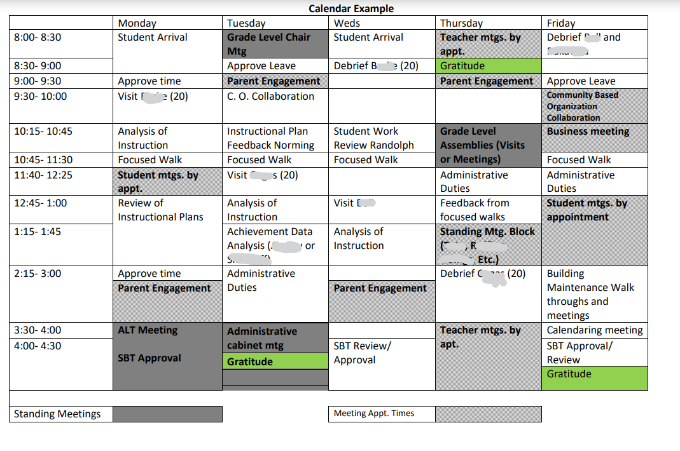
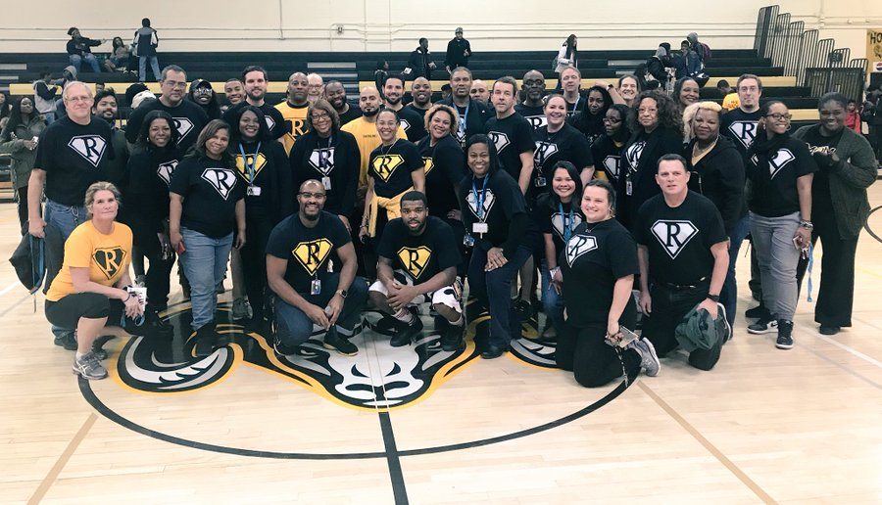
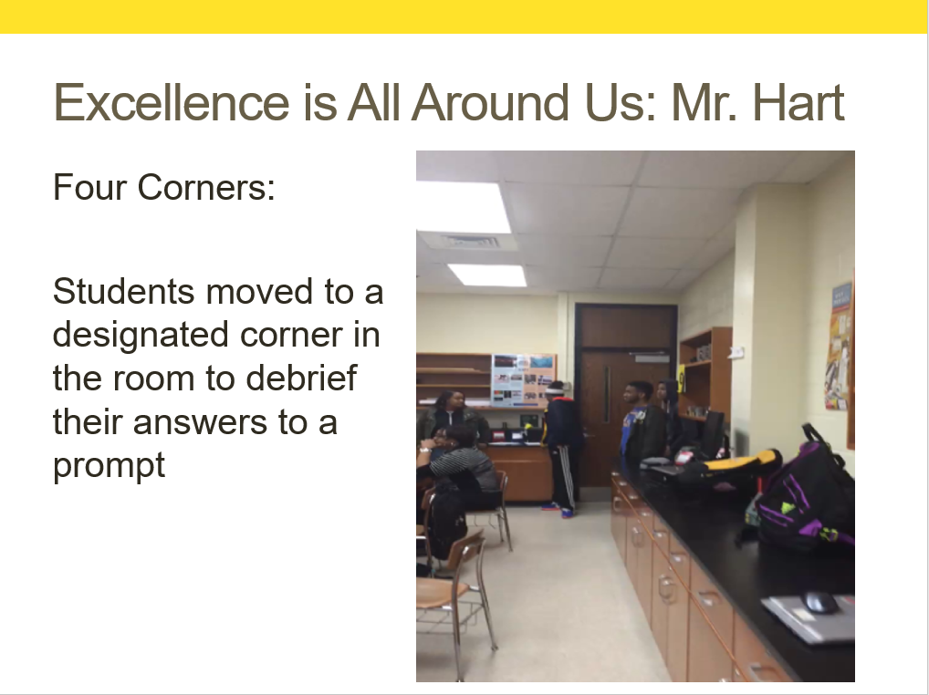
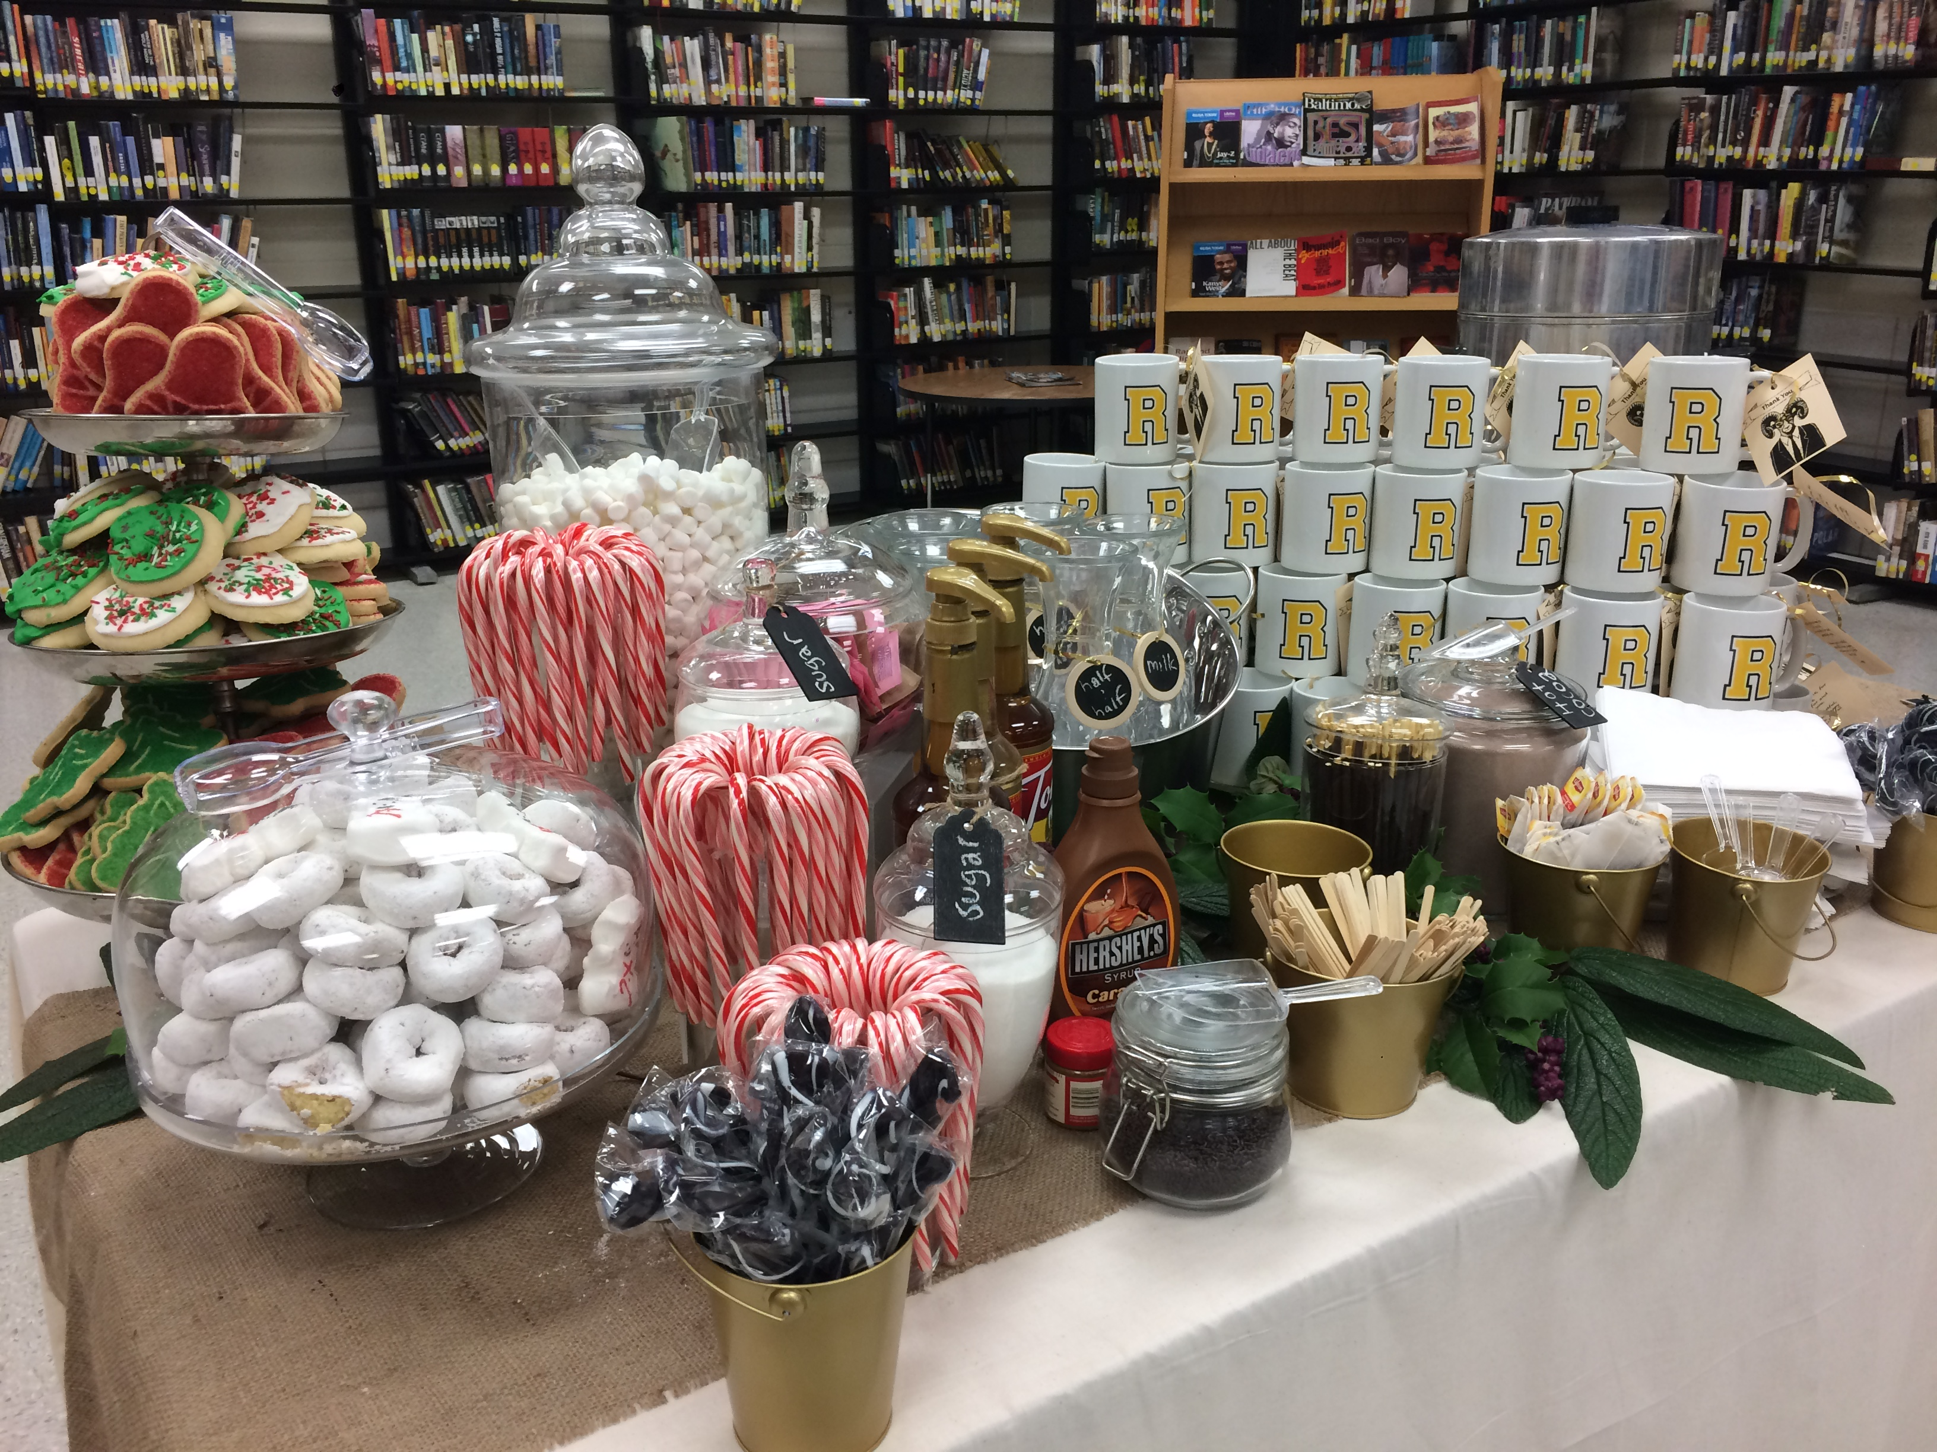
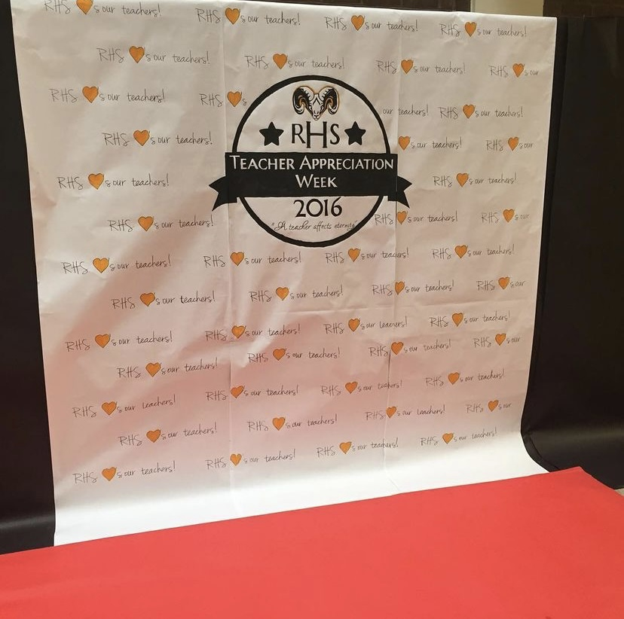
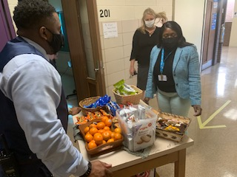
Calendar Joy and Celebration.
Don’t wait to be moved. Plan it.
Notes:
Create calendars– both weekly and yearly, that plan for celebration and gratitude. Don’t wait to be moved to say thank you for hard work, build small blocks of time into the weekly schedule to reach out to celebrate and thank your team members.
Look at the school calendar– identify the times of the year when teachers are the most strained. Plan celebrations for those times– expense is not as important as effort. Make things look special. Include celebrations that honor teaching practice– feature teachers as experts, honor their work by giving them the platform to share their practice with others.

Slide 20
Thank You!
“Find the good and praise it.”
- Alex Haley
Resources from A.P. Brown:
https://tinyurl.com/joyandthanks
@cre8tiveduc8or

Slide 21
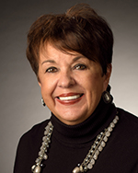
Deborah S. Phelps
Executive Director
The Education Foundation of BCPS, Inc.
Baltimore County, Maryland
Email: dphelps@bcps.org
www.linkedin.com/deborah-s-phelps-82043436

Slide 22
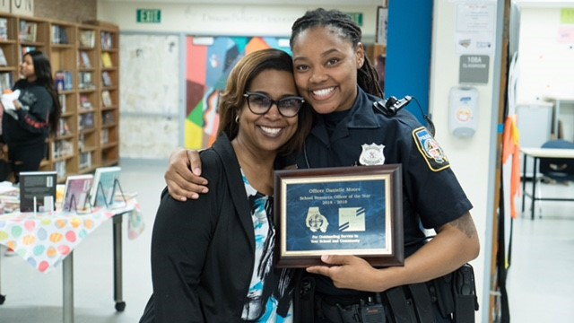
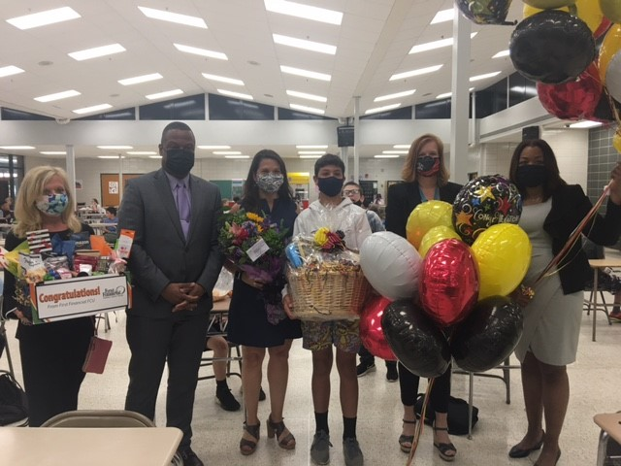
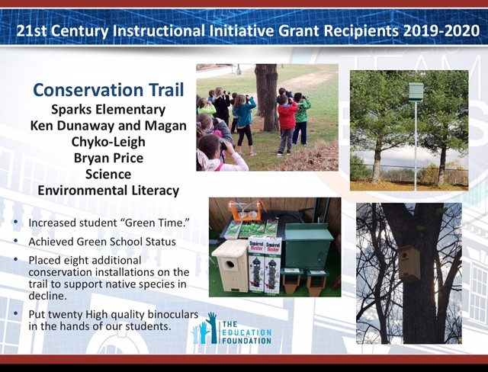
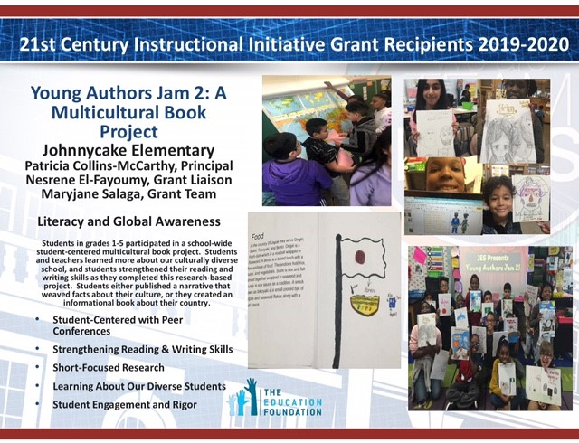

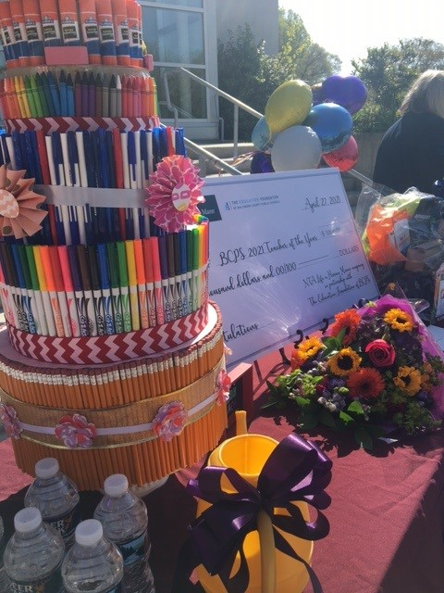
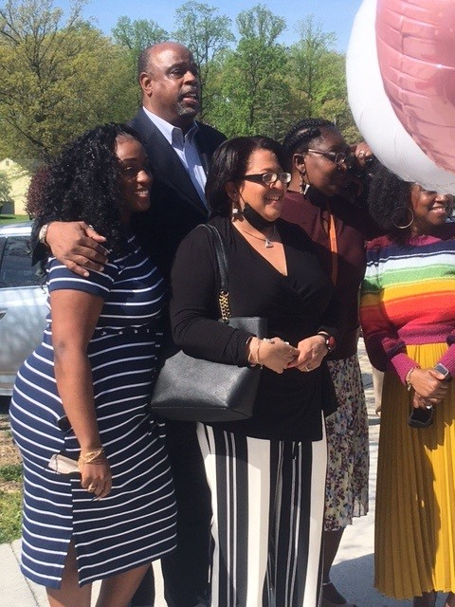
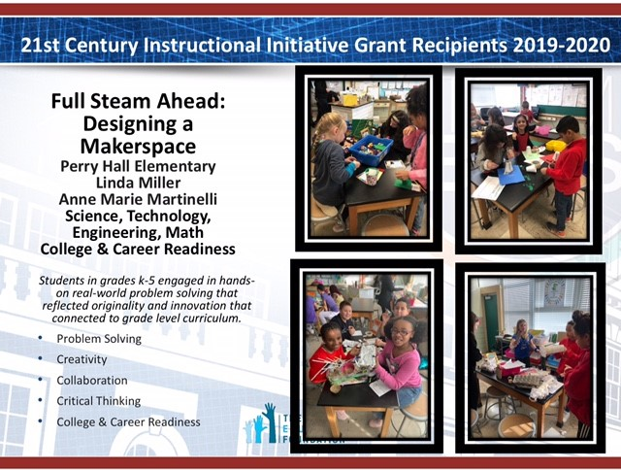

The Education Foundation of BCPS
GOALS: Fundraising | Programs | Advocacy
21st Century Innovative Grants and Projects | Scholarships | Special Initiatives
21st Century Themes
Foundation Scholarships STEM | BEEF | Books
Private Philanthropic Donor Scholarships
Notes:
Debbie

Slide 23
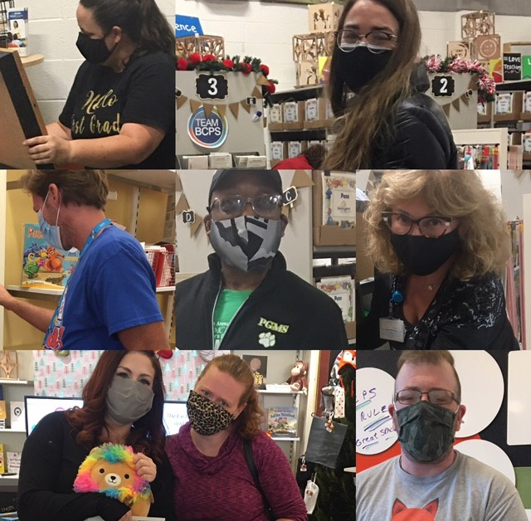
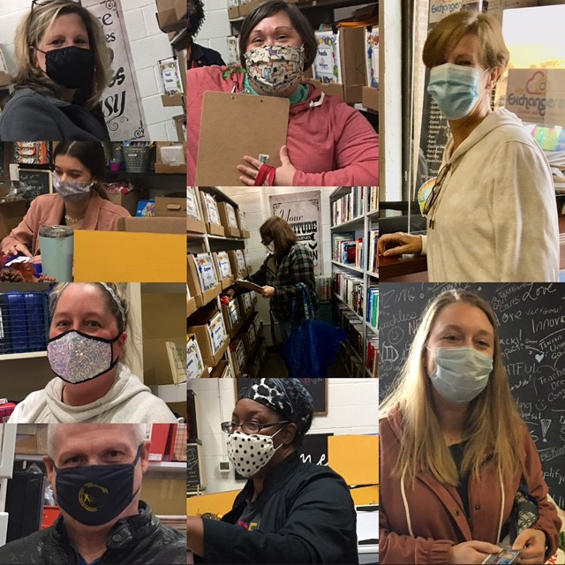
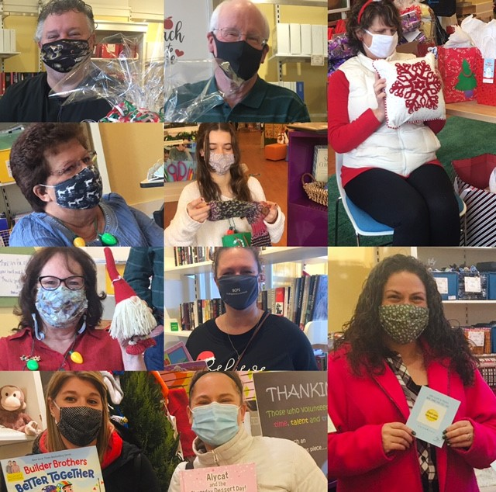


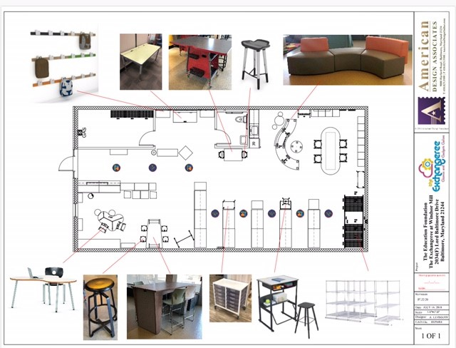
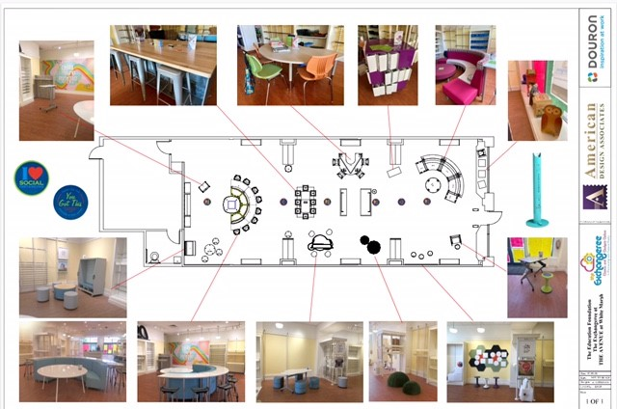
The Education Foundation of BCPS
The Exchangeree: Gizmos and Gadgets Galore
Notes:
Debbie

Slide 24

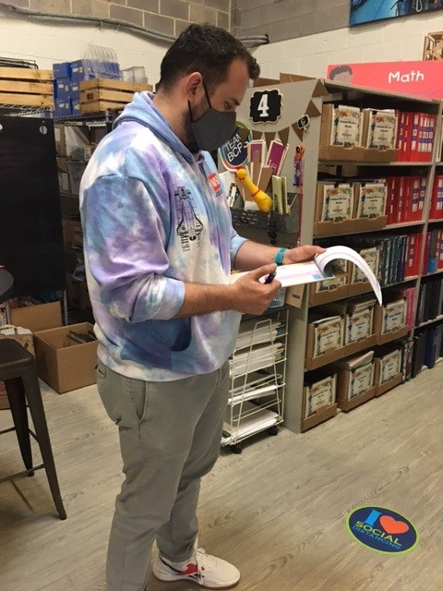

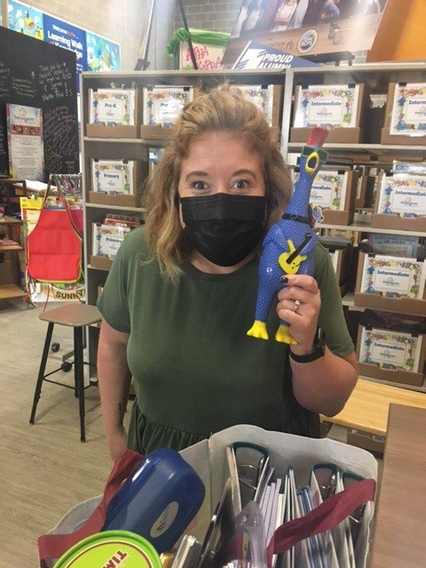
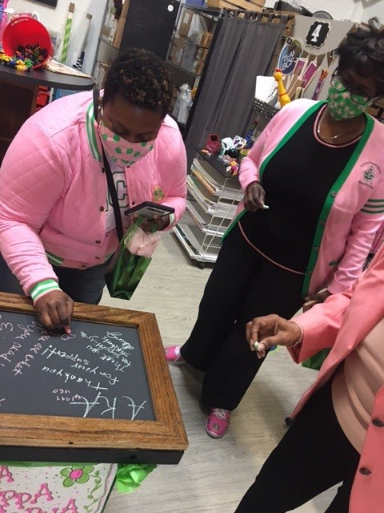





The Education Foundation of BCPS
The Exchangeree: Gizmos and Gadgets Galore
GOAL:
10,000 Books
Ongoing
Focus: August-May
Ongoing
Focus: March-May

Slide 25






The Education Foundation of BCPS
The Exchangeree: Gizmos and Gadgets Galore
Ongoing
Focus: October-January
Ongoing

Slide 26












The Education Foundation of BCPS
RISE for a Brighter Future (Relief in Securing Education)
C.A.R.E. Kits (Calming And Regulation Emotions)
ESOL Book Bundles | SEL Resources
BCPS Connects – SEL Toolkits
BCPS Therapeutic Art Supplies for Toolkits
BCPS Separate Public Day Schools
BCPS SEL SUMMIT Toolkits
AVID Presentation Boards and Educators Toolkits
RISE for a Brighter Future Brochure http://educationfoundationofbcps.org
Notes:
Debbie

Slide 27





The Education Foundation of BCPS
Contributing to a Brighter Future
Communicate to Understand
Collaborate to Support
Recognize and Celebrate with GRATITUDE
This is US! This is Team BCPS
Notes:
Debbie

Slide 28

Angela Booze
Resource Teacher
Office of Professional Learning
Baltimore County, Maryland
Email: abooze@bcps.org

Slide 29

Celebrating BCPS Principal Excellence
To commemorate this event, we are collaborating with BCPS TV in creating a video of various stakeholders and students thanking our principals through art, dance, poetry, instrumental music, vocal music, and personal testimonies.
Notes:
It is “Celebrating BCPS Principal Excellence” week in Baltimore County Public Schools during the week of May 17-22, 2021. This year for the very first time, BCPS is honoring and celebrating ALL principals in our school system. They have demonstrated remarkable leadership, commitment, and dedication to our students, families, and teachers.

Slide 30






Celebrating BCPS Principal Excellence
Art
Dance
Notes:
Angie

Slide 31

Celebrating BCPS Principal Excellence
Planting the seeds of future leaders of tomorrow
Rising to the challenge of being fierce leaders
Instilling a sense of community and belonging among all stakeholders
Never accepting less than the best from your students and your staff
Committing to creating rich learning environments
Igniting the passion for teaching and learning
Putting endless effort into the betterment of our schools
Always being a support system
Leading by example
Thank you for…
Notes:
Angie

Slide 32




Celebrating BCPS Principal Excellence
Multilingual
“Thank you for…”
Instrumental Music
Notes:
Angie

Slide 33

Personal Narrative
Share your testimony of a time this school year when a principal demonstrated outstanding leadership, commitment, dedication and/or support.

Slide 34






Celebrating BCPS Principal Excellence
Personal Testimonies
www.vidday.com and www.kudoboard.com
Notes:
Angie

Slide 35


“In a year like no other, Team BCPS celebrates all of our principals for your thoughtful leadership and your compassionate relationships with students, families, and staff. Thank you for demonstrating excellence every day!”

Slide 36

Team BCPS Education Champions
Marquee Display
Notes:
FFFCU, SECU, EDFoundation Board of Directors/Executive Committee, Chamber of Commerce throughout the Baltimore area, Smyth’s Jewelers, Baltimore Sun, Y of Central Maryland, Classic Catering People, Chick-Fil-La franchise owners in the area, THEAVENUE at White Marsh, Towson Town Center and a variety of community business partners.

Slide 37

Lead for Tomorrow
Scholarship
Established by Baltimore County Principals in Partnership with
The Education Foundation of BCPS, Inc.

Slide 38


Slide 39
Let us hear from you
Please fill out our
post-webinar
survey
Visit bit.ly/3bC0UPp
Notes:
WE NEED A LINK TO THE CORRECT PAGE FOR THIS

Slide 40

Mark your calendars
Virtual Teaching, Leading, and Learning (ViTLL) webinar
Thursday, May 20: Planning for Summer and Fall
Coming soon!
Watch for the fall schedule

Slide 41


Be an Advocate

Slide 42



Online resources
Look for follow-up resources, including a recording of this
webinar and slides
Read latest issue of
The Learning Professional
Check out the
Learning Forward blog
Use the planner at
Professional Learning State
and District Planner

Slide 43

Learning Forward memberships
Get $10 off any new Learning Forward membership
Use coupon code LFWebinars*
Visit http://learningforward.org/membership
* Code valid for new members only

Slide 44

Webinar sponsorship opportunities
Align your brand with Learning Forward’s highly popular webinar series. Thousands of professional development leaders come to Learning Forward to learn from top thought leaders through our webinar series.
Each webinar will have just one sponsor who will receive:
Company name on the
opening slide
Logo on the closing slide
Company name on the confirmation email
Company name on the webinar’s follow-up email
Banner on the webinar page
One email sent to attendees from Learning Forward on
your behalf

Slide 45


